Slide 1
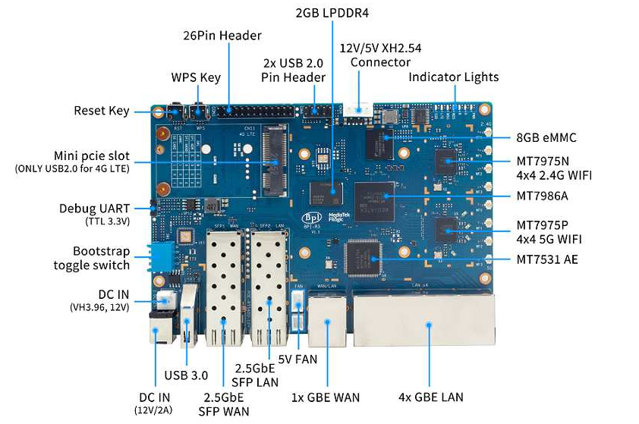
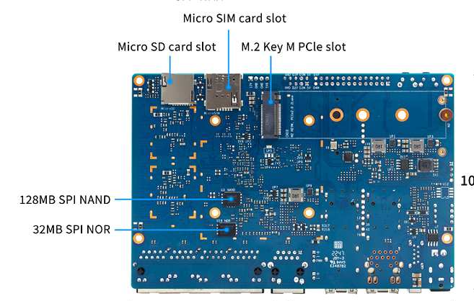
Bootup sequence of Bananapi – R3

Slide 2
Front
Storage
8GB eMMC
CPU MT7986 (4 core)
Ethernet Switch chip MT7531

Slide 3
Back
Storage
SD card
128MB SPI NAND
32MB SPI NOR

Slide 4
Summry boot sequence without OPTEE
BL1 (Boot ROM) -> BL2 -> BL31-> BL33 (U-Boot) -> Linux

Slide 5
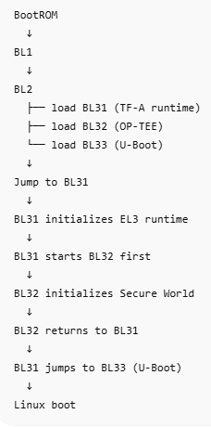
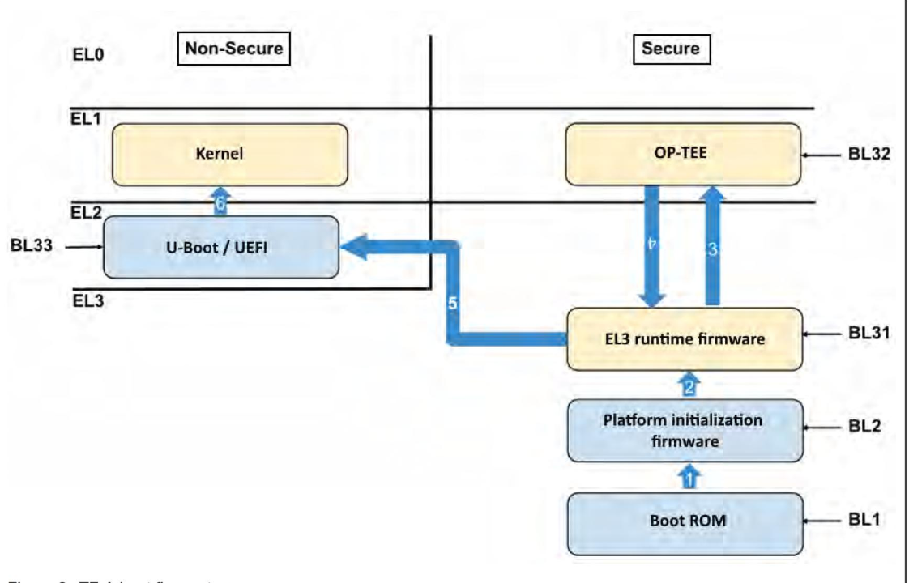
Summry boot sequence with OPTEE

Slide 6
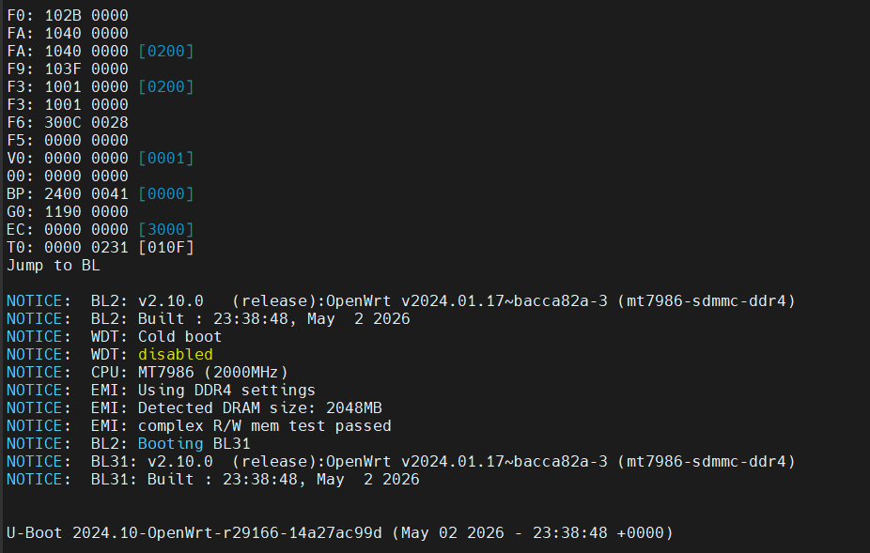








Details Phase by Phase on Banana pi R3
Refer theo Blog Bananap pi4 getting started Thì Giá trị [EC] này quyết định là bpi-r3 boot từ đâu 3000 : SD card
2000: eMMC 1000: NAND 0000: NOR

Slide 7
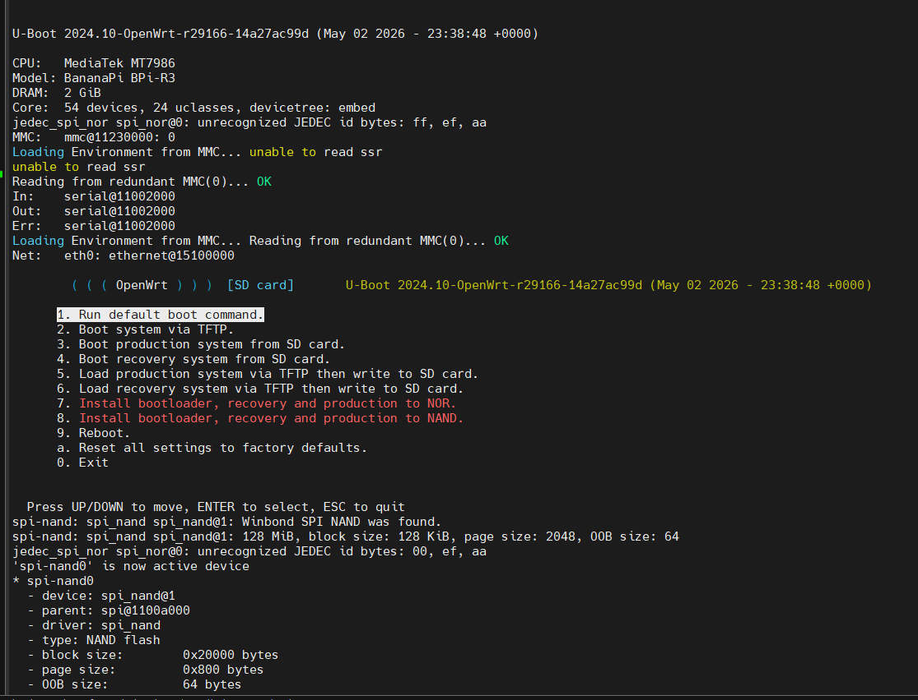
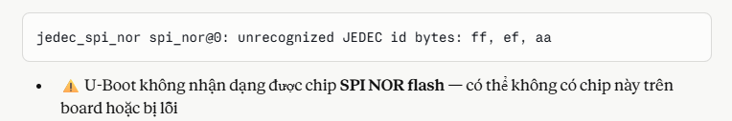



BL33 (Uboot)

Slide 8
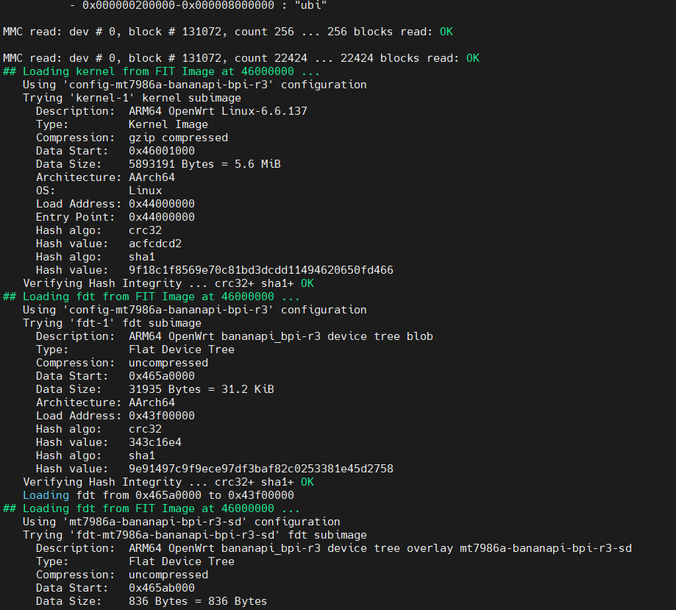
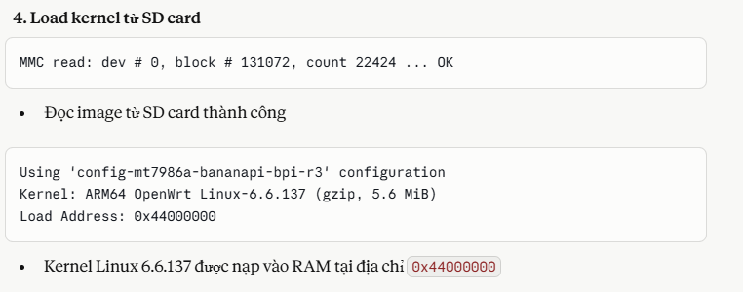
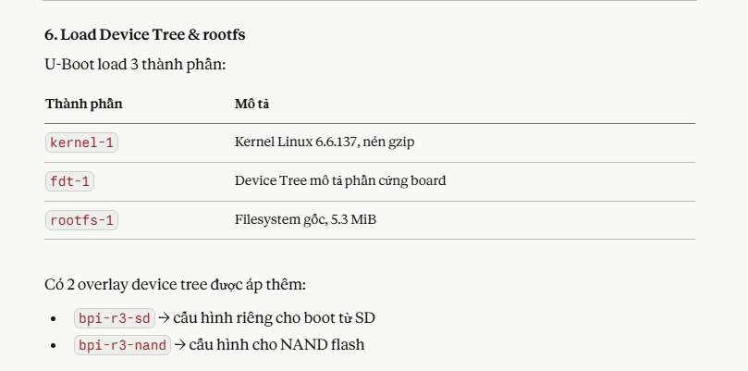
BL33 (Uboot)

Slide 9
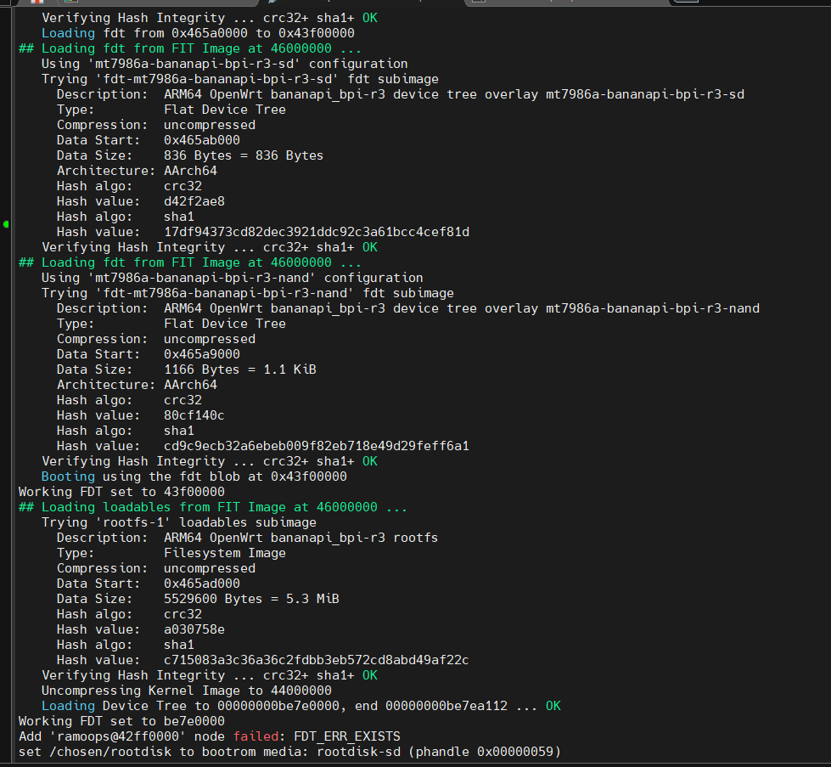
BL33 (Uboot)

Slide 10
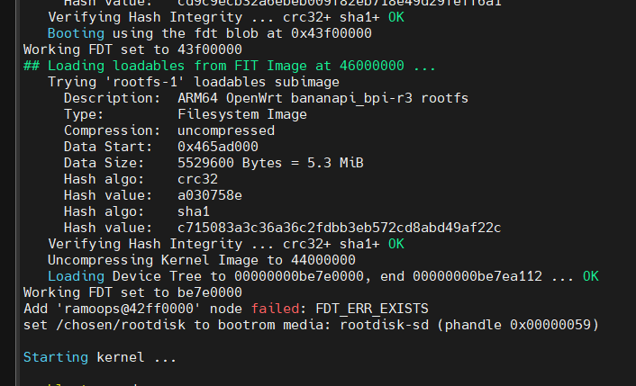

Kernel

Slide 11
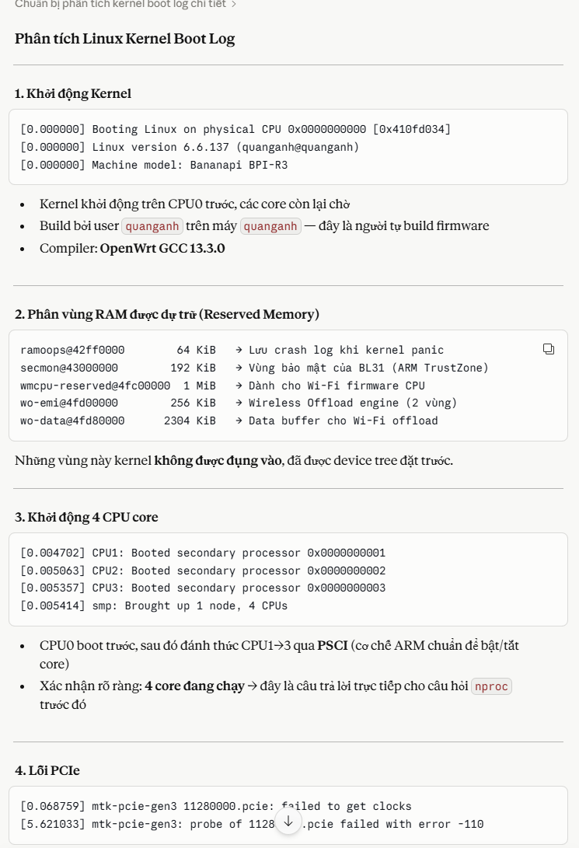
Kernel
Starting kernel ...
unable to read ssr
unable to read ssr
[ 0.000000] Booting Linux on physical CPU 0x0000000000 [0x410fd034]
[ 0.000000] Linux version 6.6.137 (quanganh@quanganh) (aarch64-openwrt-linux-musl-gcc (OpenWrt GCC 13.3.0 r29166-14a27ac99d) 13.3.0, GNU ld (GNU Binutils) 2.42) #0 SMP Sat May 2 23:38:48 20
[ 0.000000] Machine model: Bananapi BPI-R3
[ 0.000000] OF: reserved mem: 0x0000000042ff0000..0x0000000042ffffff (64 KiB) map non-reusable ramoops@42ff0000
[ 0.000000] OF: reserved mem: 0x0000000043000000..0x000000004302ffff (192 KiB) nomap non-reusable secmon@43000000
[ 0.000000] OF: reserved mem: 0x000000004fc00000..0x000000004fcfffff (1024 KiB) nomap non-reusable wmcpu-reserved@4fc00000
[ 0.000000] OF: reserved mem: 0x000000004fd00000..0x000000004fd3ffff (256 KiB) nomap non-reusable wo-emi@4fd00000
[ 0.000000] OF: reserved mem: 0x000000004fd40000..0x000000004fd7ffff (256 KiB) nomap non-reusable wo-emi@4fd40000
[ 0.000000] OF: reserved mem: 0x000000004fd80000..0x000000004ffbffff (2304 KiB) nomap non-reusable wo-data@4fd80000
[ 0.000000] Zone ranges:
[ 0.000000] DMA [mem 0x0000000040000000-0x00000000bfffffff]
[ 0.000000] DMA32 empty
[ 0.000000] Normal empty
[ 0.000000] Movable zone start for each node
[ 0.000000] Early memory node ranges
[ 0.000000] node 0: [mem 0x0000000040000000-0x0000000042ffffff]
[ 0.000000] node 0: [mem 0x0000000043000000-0x000000004302ffff]
[ 0.000000] node 0: [mem 0x0000000043030000-0x000000004fbfffff]
[ 0.000000] node 0: [mem 0x000000004fc00000-0x000000004ffbffff]
[ 0.000000] node 0: [mem 0x000000004ffc0000-0x00000000bfffffff]
[ 0.000000] Initmem setup node 0 [mem 0x0000000040000000-0x00000000bfffffff]
[ 0.000000] psci: probing for conduit method from DT.
[ 0.000000] psci: PSCIv1.1 detected in firmware.
[ 0.000000] psci: Using standard PSCI v0.2 function IDs
[ 0.000000] psci: MIGRATE_INFO_TYPE not supported.
[ 0.000000] psci: SMC Calling Convention v1.4
[ 0.000000] percpu: Embedded 18 pages/cpu s35048 r8192 d30488 u73728
[ 0.000000] pcpu-alloc: s35048 r8192 d30488 u73728 alloc=18*4096
[ 0.000000] pcpu-alloc: [0] 0 [0] 1 [0] 2 [0] 3
[ 0.000000] Detected VIPT I-cache on CPU0
[ 0.000000] CPU features: detected: GIC system register CPU interface
[ 0.000000] CPU features: kernel page table isolation disabled by kernel configuration
[ 0.000000] alternatives: applying boot alternatives
[ 0.000000] Kernel command line: root=/dev/fit0 rootwait
[ 0.000000] Dentry cache hash table entries: 262144 (order: 9, 2097152 bytes, linear)
[ 0.000000] Inode-cache hash table entries: 131072 (order: 8, 1048576 bytes, linear)
[ 0.000000] Built 1 zonelists, mobility grouping on. Total pages: 516096
[ 0.000000] mem auto-init: stack:off, heap alloc:off, heap free:off
[ 0.000000] software IO TLB: SWIOTLB bounce buffer size adjusted to 2MB
[ 0.000000] software IO TLB: area num 4.
[ 0.000000] software IO TLB: mapped [mem 0x00000000bf67f000-0x00000000bf87f000] (2MB)
[ 0.000000] Memory: 2037268K/2097152K available (8832K kernel code, 996K rwdata, 2576K rodata, 448K init, 292K bss, 59884K reserved, 0K cma-reserved)
[ 0.000000] SLUB: HWalign=64, Order=0-3, MinObjects=0, CPUs=4, Nodes=1
[ 0.000000] rcu: Hierarchical RCU implementation.
[ 0.000000] Tracing variant of Tasks RCU enabled.
[ 0.000000] rcu: RCU calculated value of scheduler-enlistment delay is 10 jiffies.
[ 0.000000] NR_IRQS: 64, nr_irqs: 64, preallocated irqs: 0
[ 0.000000] GICv3: GIC: Using split EOI/Deactivate mode
[ 0.000000] GICv3: 640 SPIs implemented
[ 0.000000] GICv3: 0 Extended SPIs implemented
[ 0.000000] Root IRQ handler: gic_handle_irq
[ 0.000000] GICv3: GICv3 features: 16 PPIs
[ 0.000000] GICv3: CPU0: found redistributor 0 region 0:0x000000000c080000
[ 0.000000] rcu: srcu_init: Setting srcu_struct sizes based on contention.
[ 0.000000] arch_timer: cp15 timer(s) running at 13.00MHz (phys).
[ 0.000000] clocksource: arch_sys_counter: mask: 0xffffffffffffff max_cycles: 0x2ff89eacb, max_idle_ns: 440795202429 ns
[ 0.000000] sched_clock: 56 bits at 13MHz, resolution 76ns, wraps every 4398046511101ns
[ 0.000064] Calibrating delay loop (skipped), value calculated using timer frequency.. 26.00 BogoMIPS (lpj=130000)
[ 0.000070] pid_max: default: 32768 minimum: 301
[ 0.002055] Mount-cache hash table entries: 4096 (order: 3, 32768 bytes, linear)
[ 0.002067] Mountpoint-cache hash table entries: 4096 (order: 3, 32768 bytes, linear)
[ 0.003631] cacheinfo: Unable to detect cache hierarchy for CPU 0
[ 0.004016] RCU Tasks Trace: Setting shift to 2 and lim to 1 rcu_task_cb_adjust=1 rcu_task_cpu_ids=4.
[ 0.004121] rcu: Hierarchical SRCU implementation.
[ 0.004123] rcu: Max phase no-delay instances is 1000.
[ 0.004442] smp: Bringing up secondary CPUs ...
[ 0.004702] Detected VIPT I-cache on CPU1
[ 0.004739] GICv3: CPU1: found redistributor 1 region 0:0x000000000c0a0000
[ 0.004767] CPU1: Booted secondary processor 0x0000000001 [0x410fd034]
[ 0.005063] Detected VIPT I-cache on CPU2
[ 0.005086] GICv3: CPU2: found redistributor 2 region 0:0x000000000c0c0000
[ 0.005096] CPU2: Booted secondary processor 0x0000000002 [0x410fd034]
[ 0.005357] Detected VIPT I-cache on CPU3
[ 0.005376] GICv3: CPU3: found redistributor 3 region 0:0x000000000c0e0000
[ 0.005386] CPU3: Booted secondary processor 0x0000000003 [0x410fd034]
[ 0.005414] smp: Brought up 1 node, 4 CPUs
[ 0.005417] SMP: Total of 4 processors activated.
[ 0.005420] CPU features: detected: 32-bit EL0 Support
[ 0.005422] CPU features: detected: CRC32 instructions
[ 0.005450] CPU features: emulated: Privileged Access Never (PAN) using TTBR0_EL1 switching
[ 0.005452] CPU: All CPU(s) started at EL2
[ 0.005454] alternatives: applying system-wide alternatives
[ 0.008551] clocksource: jiffies: mask: 0xffffffff max_cycles: 0xffffffff, max_idle_ns: 19112604462750000 ns
[ 0.008567] futex hash table entries: 1024 (order: 4, 65536 bytes, linear)
[ 0.009473] pinctrl core: initialized pinctrl subsystem
[ 0.010407] NET: Registered PF_NETLINK/PF_ROUTE protocol family
[ 0.010669] DMA: preallocated 256 KiB GFP_KERNEL pool for atomic allocations
[ 0.010697] DMA: preallocated 256 KiB GFP_KERNEL|GFP_DMA pool for atomic allocations
[ 0.010720] DMA: preallocated 256 KiB GFP_KERNEL|GFP_DMA32 pool for atomic allocations
[ 0.011024] thermal_sys: Registered thermal governor 'fair_share'
[ 0.011027] thermal_sys: Registered thermal governor 'bang_bang'
[ 0.011029] thermal_sys: Registered thermal governor 'step_wise'
[ 0.011031] thermal_sys: Registered thermal governor 'user_space'
[ 0.011070] ASID allocator initialised with 65536 entries
[ 0.011629] pstore: Using crash dump compression: deflate
[ 0.011633] pstore: Registered ramoops as persistent store backend
[ 0.011634] ramoops: using 0x10000@0x42ff0000, ecc: 0
[ 0.012778] /soc/interrupt-controller@c000000: Fixed dependency cycle(s) with /soc/interrupt-controller@c000000
[ 0.018623] Modules: 29440 pages in range for non-PLT usage
[ 0.018632] Modules: 520960 pages in range for PLT usage
[ 0.019502] cryptd: max_cpu_qlen set to 1000
[ 0.020976] SCSI subsystem initialized
[ 0.021118] libata version 3.00 loaded.
[ 0.022191] clocksource: Switched to clocksource arch_sys_counter
[ 0.023876] NET: Registered PF_INET protocol family
[ 0.023997] IP idents hash table entries: 32768 (order: 6, 262144 bytes, linear)
[ 0.025394] tcp_listen_portaddr_hash hash table entries: 1024 (order: 2, 16384 bytes, linear)
[ 0.025414] Table-perturb hash table entries: 65536 (order: 6, 262144 bytes, linear)
[ 0.025421] TCP established hash table entries: 16384 (order: 5, 131072 bytes, linear)
[ 0.025488] TCP bind hash table entries: 16384 (order: 7, 524288 bytes, linear)
[ 0.025828] TCP: Hash tables configured (established 16384 bind 16384)
[ 0.026057] MPTCP token hash table entries: 2048 (order: 4, 49152 bytes, linear)
[ 0.026167] UDP hash table entries: 1024 (order: 3, 32768 bytes, linear)
[ 0.026199] UDP-Lite hash table entries: 1024 (order: 3, 32768 bytes, linear)
[ 0.026368] NET: Registered PF_UNIX/PF_LOCAL protocol family
[ 0.026391] PCI: CLS 0 bytes, default 64
[ 0.027333] workingset: timestamp_bits=46 max_order=19 bucket_order=0
[ 0.030545] squashfs: version 4.0 (2009/01/31) Phillip Lougher
[ 0.030550] jffs2: version 2.2 (NAND) (SUMMARY) (LZMA) (RTIME) (CMODE_PRIORITY) (c) 2001-2006 Red Hat, Inc.
[ 0.068613] mtk-pcie-gen3 11280000.pcie: host bridge /soc/pcie@11280000 ranges:
[ 0.068634] mtk-pcie-gen3 11280000.pcie: Parsing ranges property...
[ 0.068643] mtk-pcie-gen3 11280000.pcie: MEM 0x0020000000..0x002fffffff -> 0x0020000000
[ 0.068750] /soc/pcie@11280000: Failed to get clk index: 0 ret: -517
[ 0.068759] mtk-pcie-gen3 11280000.pcie: failed to get clocks
[ 0.071858] Serial: 8250/16550 driver, 3 ports, IRQ sharing disabled
[ 0.072862] printk: console [ttyS0] disabled
[ 0.093220] 11002000.serial: ttyS0 at MMIO 0x11002000 (irq = 116, base_baud = 2500000) is a ST16650V2
[ 0.093259] printk: console [ttyS0] enabled
[ 0.927664] 11003000.serial: ttyS1 at MMIO 0x11003000 (irq = 117, base_baud = 1625000) is a ST16650V2
[ 0.957686] 11004000.serial: ttyS2 at MMIO 0x11004000 (irq = 118, base_baud = 1625000) is a ST16650V2
[ 0.967607] mtk_rng 1020f000.rng: registered RNG driver
[ 0.975601] loop: module loaded
[ 0.980337] spi-nand spi0.0: Winbond SPI NAND was found.
[ 0.985673] spi-nand spi0.0: 128 MiB, block size: 128 KiB, page size: 2048, OOB size: 64
[ 0.993976] 2 fixed-partitions partitions found on MTD device spi0.0
[ 1.000325] OF: Bad cell count for /soc/spi@1100a000/spi_nand@0/partitions
[ 1.007253] OF: Bad cell count for /soc/spi@1100a000/spi_nand@0/partitions
[ 1.014334] Creating 2 MTD partitions on "spi0.0":
[ 1.019115] 0x000000200000-0x000008000000 : "ubi"
[ 1.159813] ubi0: default fastmap pool size: 50
[ 1.164355] ubi0: default fastmap WL pool size: 25
[ 1.169129] ubi0: attaching mtd0
[ 4.880597] ubi0: scanning is finished
[ 4.925715] ubi0: attached mtd0 (name "ubi", size 126 MiB)
[ 4.931197] ubi0: PEB size: 131072 bytes (128 KiB), LEB size: 126976 bytes
[ 4.938059] ubi0: min./max. I/O unit sizes: 2048/2048, sub-page size 2048
[ 4.944829] ubi0: VID header offset: 2048 (aligned 2048), data offset: 4096
[ 4.951768] ubi0: good PEBs: 1008, bad PEBs: 0, corrupted PEBs: 0
[ 4.957842] ubi0: user volume: 3, internal volumes: 1, max. volumes count: 128
[ 4.965046] ubi0: max/mean erase counter: 2/0, WL threshold: 4096, image sequence number: 1642748947
[ 4.974155] ubi0: available PEBs: 493, total reserved PEBs: 515, PEBs reserved for bad PEB handling: 20
[ 4.983528] ubi0: background thread "ubi_bgt0d" started, PID 226
[ 4.985791] block ubiblock0_1: created from ubi0:1(rootfs)
[ 4.995005] ubiblock: device ubiblock0_1 (rootfs) set to be root filesystem
[ 5.002069] 0x000000000000-0x000000200000 : "bl2"
[ 5.146672] mtk_soc_eth 15100000.ethernet eth0: mediatek frame engine at 0xffffffc081700000, irq 123
[ 5.156455] mtk_soc_eth 15100000.ethernet eth1: mediatek frame engine at 0xffffffc081700000, irq 123
[ 5.166152] i2c_dev: i2c /dev entries driver
[ 5.172422] mtk-wdt 1001c000.watchdog: Watchdog enabled (timeout=31 sec, nowayout=0)
[ 5.180994] NET: Registered PF_INET6 protocol family
[ 5.186601] Segment Routing with IPv6
[ 5.190271] In-situ OAM (IOAM) with IPv6
[ 5.194236] NET: Registered PF_PACKET protocol family
[ 5.199336] 8021q: 802.1Q VLAN Support v1.8
[ 5.217012] mtk-pcie-gen3 11280000.pcie: host bridge /soc/pcie@11280000 ranges:
[ 5.224353] mtk-pcie-gen3 11280000.pcie: Parsing ranges property...
[ 5.230610] mtk-pcie-gen3 11280000.pcie: MEM 0x0020000000..0x002fffffff -> 0x0020000000
[ 5.239075] debugfs: File 'type' in directory 'phy-soc:t-phy@11c00000.0' already present!
[ 5.247237] debugfs: File 'efuse' in directory 'phy-soc:t-phy@11c00000.0' already present!
[ 5.255479] debugfs: File 'intr' in directory 'phy-soc:t-phy@11c00000.0' already present!
[ 5.263634] debugfs: File 'tx-imp' in directory 'phy-soc:t-phy@11c00000.0' already present!
[ 5.271960] debugfs: File 'rx-imp' in directory 'phy-soc:t-phy@11c00000.0' already present!
[ 5.612218] mtk-pcie-gen3 11280000.pcie: PCIe link down, current LTSSM state: detect.quiet (0x1)
[ 5.621033] mtk-pcie-gen3: probe of 11280000.pcie failed with error -110
[ 5.714515] mt7530-mdio mdio-bus:1f: configuring for fixed/2500base-x link mode
[ 5.723558] mt7530-mdio mdio-bus:1f: Link is Up - 2.5Gbps/Full - flow control rx/tx
[ 5.734040] mt7530-mdio mdio-bus:1f wan (uninitialized): PHY [mt7530-0:00] driver [MediaTek MT7531 PHY] (irq=128)
[ 5.756122] mt7530-mdio mdio-bus:1f lan1 (uninitialized): PHY [mt7530-0:01] driver [MediaTek MT7531 PHY] (irq=129)
[ 5.777988] mt7530-mdio mdio-bus:1f lan2 (uninitialized): PHY [mt7530-0:02] driver [MediaTek MT7531 PHY] (irq=130)
[ 5.799839] mt7530-mdio mdio-bus:1f lan3 (uninitialized): PHY [mt7530-0:03] driver [MediaTek MT7531 PHY] (irq=131)
[ 5.821686] mt7530-mdio mdio-bus:1f lan4 (uninitialized): PHY [mt7530-0:04] driver [MediaTek MT7531 PHY] (irq=132)
[ 5.832984] mtk_soc_eth 15100000.ethernet eth0: entered promiscuous mode
[ 5.839701] DSA: tree 0 setup
[ 5.843201] clk: Disabling unused clocks
[ 5.869924] Waiting for root device /dev/fit0...
[ 5.910094] mmc0: host does not support reading read-only switch, assuming write-enable
[ 5.924022] mmc0: new high speed SDHC card at address e624
[ 5.930302] mmcblk0: mmc0:e624 SC32G 29.7 GiB
[ 5.940697] Alternate GPT is invalid, using primary GPT.
[ 5.946019] mmcblk0: p1 p2 p3 p4 p5 p6 p7
[ 5.953214] FIT: Detected U-Boot 2024.10-OpenWrt-r29166-14a27ac99d
[ 5.959391] FIT: Selected configuration: "config-mt7986a-bananapi-bpi-r3" (OpenWrt bananapi_bpi-r3)
[ 5.968428] FIT: kernel sub-image 0x00001000..0x0059fc46 "kernel-1" (ARM64 OpenWrt Linux-6.6.137)
[ 5.978241] FIT: flat_dt sub-image 0x005a0000..0x005a7cbe "fdt-1" (ARM64 OpenWrt bananapi_bpi-r3 device tree blob)
[ 5.989443] FIT: flat_dt sub-image 0x005a8000..0x005a83dd "fdt-mt7986a-bananapi-bpi-r3-emmc" (ARM64 OpenWrt bananapi_bpi-r3 device tree overlay mt7986a-bananapi-bpi-r3-emmc)
[ 6.005762] FIT: flat_dt sub-image 0x005a9000..0x005a948d "fdt-mt7986a-bananapi-bpi-r3-nand" (ARM64 OpenWrt bananapi_bpi-r3 device tree overlay mt7986a-bananapi-bpi-r3-nand)
[ 6.022077] FIT: flat_dt sub-image 0x005aa000..0x005aa4bd "fdt-mt7986a-bananapi-bpi-r3-nor" (ARM64 OpenWrt bananapi_bpi-r3 device tree overlay mt7986a-bananapi-bpi-r3-nor)
[ 6.038218] FIT: flat_dt sub-image 0x005ab000..0x005ab343 "fdt-mt7986a-bananapi-bpi-r3-sd" (ARM64 OpenWrt bananapi_bpi-r3 device tree overlay mt7986a-bananapi-bpi-r3-sd)
[ 6.054186] FIT: flat_dt sub-image 0x005ac000..0x005ac555 "fdt-mt7986a-bananapi-bpi-r3-respeaker-2mics" (ARM64 OpenWrt bananapi_bpi-r3 device tree overlay mt7986a-bananapi-bpi-r3-reer-2mics)
[ 6.072406] FIT: filesystem sub-image 0x005ad000..0x00af2fff "rootfs-1" (ARM64 OpenWrt bananapi_bpi-r3 rootfs)
[ 6.083338] block mmcblk0p7: mapped 1 uImage.FIT filesystem sub-image as /dev/fit0
[ 6.091146] block mmcblk0p7: mapped remaining space as /dev/fitrw
[ 6.131543] VFS: Mounted root (squashfs filesystem) readonly on device 259:0.
[ 6.138836] Freeing unused kernel memory: 448K
[ 6.143293] Run /sbin/init as init process
[ 6.147372] with arguments:
[ 6.150323] /sbin/init
[ 6.153018] with environment:
[ 6.156142] HOME=/
[ 6.158487] TERM=linux
[ 6.303599] init: Console is alive
[ 6.307081] init: - watchdog -
[ 6.620641] kmodloader: loading kernel modules from /etc/modules-boot.d/*
[ 6.649458] usbcore: registered new interface driver usbfs
[ 6.655003] usbcore: registered new interface driver hub
[ 6.660331] usbcore: registered new device driver usb
[ 6.665969] gpio_button_hotplug: loading out-of-tree module taints kernel.
[ 6.676815] xhci-mtk 11200000.usb: supply vbus not found, using dummy regulator
[ 6.684234] xhci-mtk 11200000.usb: supply vusb33 not found, using dummy regulator
[ 6.692568] xhci-mtk 11200000.usb: xHCI Host Controller
[ 6.697794] xhci-mtk 11200000.usb: new USB bus registered, assigned bus number 1
[ 6.708311] xhci-mtk 11200000.usb: hcc params 0x01403f99 hci version 0x110 quirks 0x0000000000200010
[ 6.717466] xhci-mtk 11200000.usb: irq 134, io mem 0x11200000
[ 6.723318] xhci-mtk 11200000.usb: xHCI Host Controller
[ 6.728529] xhci-mtk 11200000.usb: new USB bus registered, assigned bus number 2
[ 6.735909] xhci-mtk 11200000.usb: Host supports USB 3.2 Enhanced SuperSpeed
[ 6.743316] hub 1-0:1.0: USB hub found
[ 6.747076] hub 1-0:1.0: 2 ports detected
[ 6.751335] usb usb2: We don't know the algorithms for LPM for this host, disabling LPM.
[ 6.759696] hub 2-0:1.0: USB hub found
[ 6.763464] hub 2-0:1.0: 1 port detected
[ 6.770670] kmodloader: done loading kernel modules from /etc/modules-boot.d/*
[ 6.779756] init: - preinit -
[ 7.011338] mtk_soc_eth 15100000.ethernet eth0: configuring for fixed/2500base-x link mode
[ 7.019908] mtk_soc_eth 15100000.ethernet eth0: Link is Up - 2.5Gbps/Full - flow control rx/tx
[ 7.038200] mt7530-mdio mdio-bus:1f lan1: configuring for phy/gmii link mode
Press the [f] key and hit [enter] to enter failsafe mode
Press the [1], [2], [3] or [4] key and hit [enter] to select the debug level
[ 7.202210] usb 1-1: new high-speed USB device number 2 using xhci-mtk
[ 7.394363] hub 1-1:1.0: USB hub found
[ 7.402007] hub 1-1:1.0: 4 ports detected
[ 9.572197] random: crng init done
[ 11.700853] F2FS-fs (fitrw): Mounted with checkpoint version = 3999c4ea
[ 11.709269] mount_root: switching to f2fs overlay
[ 11.715886] overlayfs: null uuid detected in lower fs '/', falling back to xino=off,index=off,nfs_export=off.
[ 11.729808] urandom-seed: Seeding with /etc/urandom.seed
[ 11.773752] procd: - early -
[ 11.776680] procd: - watchdog -
[ 12.307388] procd: - watchdog -
[ 12.310879] procd: - ubus -
[ 12.464034] procd: - init -
Please press Enter to activate this console.
[ 12.718883] kmodloader: loading kernel modules from /etc/modules.d/*
[ 12.746947] i2c-gpio i2c-gpio-0: using lines 528 (SDA) and 529 (SCL)
[ 12.753663] i2c-gpio i2c-gpio-1: using lines 530 (SDA) and 531 (SCL)
[ 12.763453] crypto-safexcel 10320000.crypto: EIP97:230(0,1,4,4)-HIA:270(0,5,5),PE:150/433(alg:7fcdfc00)/0/0/0
[ 12.777878] Loading modules backported from Linux version v6.12.61-0-gdcbeffaf66d0
[ 12.785464] Backport generated by backports.git v6.1.110-1-35-g410656ef
[ 12.796904] sfp sfp-1: Host maximum power 3.0W
[ 12.801957] sfp sfp-2: Host maximum power 3.0W
[ 12.859788] urngd: v1.0.2 started.
[ 13.265172] mt798x-wmac 18000000.wifi: HW/SW Version: 0x8a108a10, Build Time: 20240823160739a
[ 13.265172]
[ 13.400496] mt798x-wmac 18000000.wifi: WM Firmware Version: ____000000, Build Time: 20240823160804
[ 13.505615] mt798x-wmac 18000000.wifi: WA Firmware Version: DEV_000000, Build Time: 20240823160840
[ 13.611262] mt798x-wmac 18000000.wifi: registering led 'mt76-phy0'
[ 13.663456] mt798x-wmac 18000000.wifi: registering led 'mt76-phy1'
[ 13.762416] PPP generic driver version 2.4.2
[ 13.767502] NET: Registered PF_PPPOX protocol family
[ 13.774884] kmodloader: done loading kernel modules from /etc/modules.d/*
[ 15.708564] mtk_soc_eth 15100000.ethernet eth0: Link is Down
[ 15.723997] mtk_soc_eth 15100000.ethernet eth0: configuring for fixed/2500base-x link mode
[ 15.732456] mtk_soc_eth 15100000.ethernet eth0: Link is Up - 2.5Gbps/Full - flow control rx/tx
[ 15.738862] mt7530-mdio mdio-bus:1f lan1: configuring for phy/gmii link mode
[ 15.751964] br-lan: port 1(lan1) entered blocking state
[ 15.757206] br-lan: port 1(lan1) entered disabled state
[ 15.762447] mt7530-mdio mdio-bus:1f lan1: entered allmulticast mode
[ 15.768697] mtk_soc_eth 15100000.ethernet eth0: entered allmulticast mode
[ 15.778455] mt7530-mdio mdio-bus:1f lan1: entered promiscuous mode
[ 15.796712] mt7530-mdio mdio-bus:1f lan2: configuring for phy/gmii link mode
[ 15.807581] br-lan: port 2(lan2) entered blocking state
[ 15.812861] br-lan: port 2(lan2) entered disabled state
[ 15.818114] mt7530-mdio mdio-bus:1f lan2: entered allmulticast mode
[ 15.826175] mt7530-mdio mdio-bus:1f lan2: entered promiscuous mode
[ 15.840993] mt7530-mdio mdio-bus:1f lan3: configuring for phy/gmii link mode
[ 15.851796] br-lan: port 3(lan3) entered blocking state
[ 15.857057] br-lan: port 3(lan3) entered disabled state
[ 15.862327] mt7530-mdio mdio-bus:1f lan3: entered allmulticast mode
[ 15.870439] mt7530-mdio mdio-bus:1f lan3: entered promiscuous mode
[ 15.885501] mt7530-mdio mdio-bus:1f lan4: configuring for phy/gmii link mode
[ 15.896191] br-lan: port 4(lan4) entered blocking state
[ 15.901416] br-lan: port 4(lan4) entered disabled state
[ 15.906732] mt7530-mdio mdio-bus:1f lan4: entered allmulticast mode
[ 15.915009] mt7530-mdio mdio-bus:1f lan4: entered promiscuous mode
[ 15.924265] mt7530-mdio mdio-bus:1f sfp2: configuring for inband/2500base-x link mode
[ 15.933691] br-lan: port 5(sfp2) entered blocking state
[ 15.938906] br-lan: port 5(sfp2) entered disabled state
[ 15.944168] mt7530-mdio mdio-bus:1f sfp2: entered allmulticast mode
[ 15.952587] mt7530-mdio mdio-bus:1f sfp2: entered promiscuous mode
[ 15.962063] mtk_soc_eth 15100000.ethernet eth1: configuring for inband/2500base-x link mode
[ 15.972276] br-wan: port 1(eth1) entered blocking state
[ 15.977508] br-wan: port 1(eth1) entered disabled state
[ 15.982788] mtk_soc_eth 15100000.ethernet eth1: entered allmulticast mode
[ 15.989757] mtk_soc_eth 15100000.ethernet eth1: entered promiscuous mode
[ 16.004994] mt7530-mdio mdio-bus:1f wan: configuring for phy/gmii link mode
[ 16.015717] br-wan: port 2(wan) entered blocking state
[ 16.020855] br-wan: port 2(wan) entered disabled state
[ 16.026034] mt7530-mdio mdio-bus:1f wan: entered allmulticast mode
[ 16.034107] mt7530-mdio mdio-bus:1f wan: entered promiscuous mode
[ 19.535776] mt7530-mdio mdio-bus:1f lan4: Link is Up - 1Gbps/Full - flow control rx/tx
[ 19.535800] br-lan: port 4(lan4) entered blocking state
[ 19.548902] br-lan: port 4(lan4) entered forwarding state
BusyBox v1.36.1 (2026-05-02 23:38:48 UTC) built-in shell (ash)

Slide 12
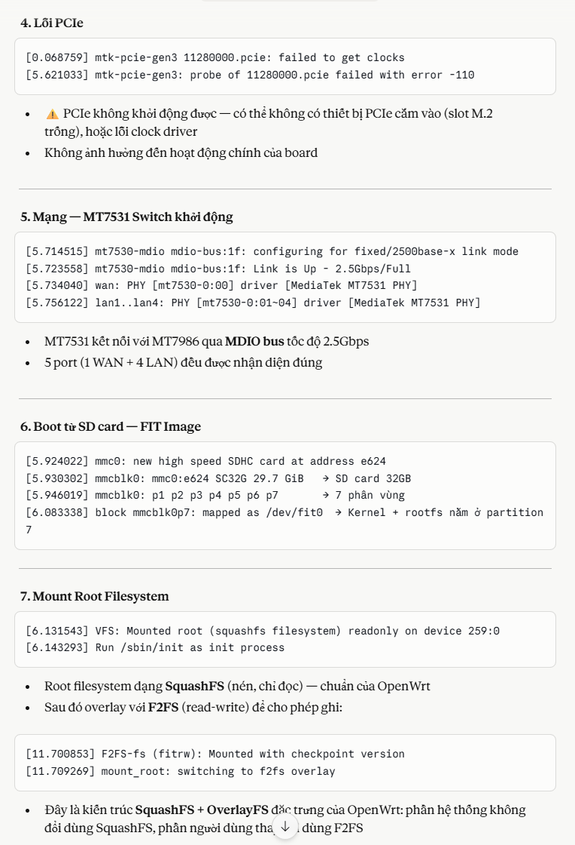
Kernel
Starting kernel ...
unable to read ssr
unable to read ssr
[ 0.000000] Booting Linux on physical CPU 0x0000000000 [0x410fd034]
[ 0.000000] Linux version 6.6.137 (quanganh@quanganh) (aarch64-openwrt-linux-musl-gcc (OpenWrt GCC 13.3.0 r29166-14a27ac99d) 13.3.0, GNU ld (GNU Binutils) 2.42) #0 SMP Sat May 2 23:38:48 20
[ 0.000000] Machine model: Bananapi BPI-R3
[ 0.000000] OF: reserved mem: 0x0000000042ff0000..0x0000000042ffffff (64 KiB) map non-reusable ramoops@42ff0000
[ 0.000000] OF: reserved mem: 0x0000000043000000..0x000000004302ffff (192 KiB) nomap non-reusable secmon@43000000
[ 0.000000] OF: reserved mem: 0x000000004fc00000..0x000000004fcfffff (1024 KiB) nomap non-reusable wmcpu-reserved@4fc00000
[ 0.000000] OF: reserved mem: 0x000000004fd00000..0x000000004fd3ffff (256 KiB) nomap non-reusable wo-emi@4fd00000
[ 0.000000] OF: reserved mem: 0x000000004fd40000..0x000000004fd7ffff (256 KiB) nomap non-reusable wo-emi@4fd40000
[ 0.000000] OF: reserved mem: 0x000000004fd80000..0x000000004ffbffff (2304 KiB) nomap non-reusable wo-data@4fd80000
[ 0.000000] Zone ranges:
[ 0.000000] DMA [mem 0x0000000040000000-0x00000000bfffffff]
[ 0.000000] DMA32 empty
[ 0.000000] Normal empty
[ 0.000000] Movable zone start for each node
[ 0.000000] Early memory node ranges
[ 0.000000] node 0: [mem 0x0000000040000000-0x0000000042ffffff]
[ 0.000000] node 0: [mem 0x0000000043000000-0x000000004302ffff]
[ 0.000000] node 0: [mem 0x0000000043030000-0x000000004fbfffff]
[ 0.000000] node 0: [mem 0x000000004fc00000-0x000000004ffbffff]
[ 0.000000] node 0: [mem 0x000000004ffc0000-0x00000000bfffffff]
[ 0.000000] Initmem setup node 0 [mem 0x0000000040000000-0x00000000bfffffff]
[ 0.000000] psci: probing for conduit method from DT.
[ 0.000000] psci: PSCIv1.1 detected in firmware.
[ 0.000000] psci: Using standard PSCI v0.2 function IDs
[ 0.000000] psci: MIGRATE_INFO_TYPE not supported.
[ 0.000000] psci: SMC Calling Convention v1.4
[ 0.000000] percpu: Embedded 18 pages/cpu s35048 r8192 d30488 u73728
[ 0.000000] pcpu-alloc: s35048 r8192 d30488 u73728 alloc=18*4096
[ 0.000000] pcpu-alloc: [0] 0 [0] 1 [0] 2 [0] 3
[ 0.000000] Detected VIPT I-cache on CPU0
[ 0.000000] CPU features: detected: GIC system register CPU interface
[ 0.000000] CPU features: kernel page table isolation disabled by kernel configuration
[ 0.000000] alternatives: applying boot alternatives
[ 0.000000] Kernel command line: root=/dev/fit0 rootwait
[ 0.000000] Dentry cache hash table entries: 262144 (order: 9, 2097152 bytes, linear)
[ 0.000000] Inode-cache hash table entries: 131072 (order: 8, 1048576 bytes, linear)
[ 0.000000] Built 1 zonelists, mobility grouping on. Total pages: 516096
[ 0.000000] mem auto-init: stack:off, heap alloc:off, heap free:off
[ 0.000000] software IO TLB: SWIOTLB bounce buffer size adjusted to 2MB
[ 0.000000] software IO TLB: area num 4.
[ 0.000000] software IO TLB: mapped [mem 0x00000000bf67f000-0x00000000bf87f000] (2MB)
[ 0.000000] Memory: 2037268K/2097152K available (8832K kernel code, 996K rwdata, 2576K rodata, 448K init, 292K bss, 59884K reserved, 0K cma-reserved)
[ 0.000000] SLUB: HWalign=64, Order=0-3, MinObjects=0, CPUs=4, Nodes=1
[ 0.000000] rcu: Hierarchical RCU implementation.
[ 0.000000] Tracing variant of Tasks RCU enabled.
[ 0.000000] rcu: RCU calculated value of scheduler-enlistment delay is 10 jiffies.
[ 0.000000] NR_IRQS: 64, nr_irqs: 64, preallocated irqs: 0
[ 0.000000] GICv3: GIC: Using split EOI/Deactivate mode
[ 0.000000] GICv3: 640 SPIs implemented
[ 0.000000] GICv3: 0 Extended SPIs implemented
[ 0.000000] Root IRQ handler: gic_handle_irq
[ 0.000000] GICv3: GICv3 features: 16 PPIs
[ 0.000000] GICv3: CPU0: found redistributor 0 region 0:0x000000000c080000
[ 0.000000] rcu: srcu_init: Setting srcu_struct sizes based on contention.
[ 0.000000] arch_timer: cp15 timer(s) running at 13.00MHz (phys).
[ 0.000000] clocksource: arch_sys_counter: mask: 0xffffffffffffff max_cycles: 0x2ff89eacb, max_idle_ns: 440795202429 ns
[ 0.000000] sched_clock: 56 bits at 13MHz, resolution 76ns, wraps every 4398046511101ns
[ 0.000064] Calibrating delay loop (skipped), value calculated using timer frequency.. 26.00 BogoMIPS (lpj=130000)
[ 0.000070] pid_max: default: 32768 minimum: 301
[ 0.002055] Mount-cache hash table entries: 4096 (order: 3, 32768 bytes, linear)
[ 0.002067] Mountpoint-cache hash table entries: 4096 (order: 3, 32768 bytes, linear)
[ 0.003631] cacheinfo: Unable to detect cache hierarchy for CPU 0
[ 0.004016] RCU Tasks Trace: Setting shift to 2 and lim to 1 rcu_task_cb_adjust=1 rcu_task_cpu_ids=4.
[ 0.004121] rcu: Hierarchical SRCU implementation.
[ 0.004123] rcu: Max phase no-delay instances is 1000.
[ 0.004442] smp: Bringing up secondary CPUs ...
[ 0.004702] Detected VIPT I-cache on CPU1
[ 0.004739] GICv3: CPU1: found redistributor 1 region 0:0x000000000c0a0000
[ 0.004767] CPU1: Booted secondary processor 0x0000000001 [0x410fd034]
[ 0.005063] Detected VIPT I-cache on CPU2
[ 0.005086] GICv3: CPU2: found redistributor 2 region 0:0x000000000c0c0000
[ 0.005096] CPU2: Booted secondary processor 0x0000000002 [0x410fd034]
[ 0.005357] Detected VIPT I-cache on CPU3
[ 0.005376] GICv3: CPU3: found redistributor 3 region 0:0x000000000c0e0000
[ 0.005386] CPU3: Booted secondary processor 0x0000000003 [0x410fd034]
[ 0.005414] smp: Brought up 1 node, 4 CPUs
[ 0.005417] SMP: Total of 4 processors activated.
[ 0.005420] CPU features: detected: 32-bit EL0 Support
[ 0.005422] CPU features: detected: CRC32 instructions
[ 0.005450] CPU features: emulated: Privileged Access Never (PAN) using TTBR0_EL1 switching
[ 0.005452] CPU: All CPU(s) started at EL2
[ 0.005454] alternatives: applying system-wide alternatives
[ 0.008551] clocksource: jiffies: mask: 0xffffffff max_cycles: 0xffffffff, max_idle_ns: 19112604462750000 ns
[ 0.008567] futex hash table entries: 1024 (order: 4, 65536 bytes, linear)
[ 0.009473] pinctrl core: initialized pinctrl subsystem
[ 0.010407] NET: Registered PF_NETLINK/PF_ROUTE protocol family
[ 0.010669] DMA: preallocated 256 KiB GFP_KERNEL pool for atomic allocations
[ 0.010697] DMA: preallocated 256 KiB GFP_KERNEL|GFP_DMA pool for atomic allocations
[ 0.010720] DMA: preallocated 256 KiB GFP_KERNEL|GFP_DMA32 pool for atomic allocations
[ 0.011024] thermal_sys: Registered thermal governor 'fair_share'
[ 0.011027] thermal_sys: Registered thermal governor 'bang_bang'
[ 0.011029] thermal_sys: Registered thermal governor 'step_wise'
[ 0.011031] thermal_sys: Registered thermal governor 'user_space'
[ 0.011070] ASID allocator initialised with 65536 entries
[ 0.011629] pstore: Using crash dump compression: deflate
[ 0.011633] pstore: Registered ramoops as persistent store backend
[ 0.011634] ramoops: using 0x10000@0x42ff0000, ecc: 0
[ 0.012778] /soc/interrupt-controller@c000000: Fixed dependency cycle(s) with /soc/interrupt-controller@c000000
[ 0.018623] Modules: 29440 pages in range for non-PLT usage
[ 0.018632] Modules: 520960 pages in range for PLT usage
[ 0.019502] cryptd: max_cpu_qlen set to 1000
[ 0.020976] SCSI subsystem initialized
[ 0.021118] libata version 3.00 loaded.
[ 0.022191] clocksource: Switched to clocksource arch_sys_counter
[ 0.023876] NET: Registered PF_INET protocol family
[ 0.023997] IP idents hash table entries: 32768 (order: 6, 262144 bytes, linear)
[ 0.025394] tcp_listen_portaddr_hash hash table entries: 1024 (order: 2, 16384 bytes, linear)
[ 0.025414] Table-perturb hash table entries: 65536 (order: 6, 262144 bytes, linear)
[ 0.025421] TCP established hash table entries: 16384 (order: 5, 131072 bytes, linear)
[ 0.025488] TCP bind hash table entries: 16384 (order: 7, 524288 bytes, linear)
[ 0.025828] TCP: Hash tables configured (established 16384 bind 16384)
[ 0.026057] MPTCP token hash table entries: 2048 (order: 4, 49152 bytes, linear)
[ 0.026167] UDP hash table entries: 1024 (order: 3, 32768 bytes, linear)
[ 0.026199] UDP-Lite hash table entries: 1024 (order: 3, 32768 bytes, linear)
[ 0.026368] NET: Registered PF_UNIX/PF_LOCAL protocol family
[ 0.026391] PCI: CLS 0 bytes, default 64
[ 0.027333] workingset: timestamp_bits=46 max_order=19 bucket_order=0
[ 0.030545] squashfs: version 4.0 (2009/01/31) Phillip Lougher
[ 0.030550] jffs2: version 2.2 (NAND) (SUMMARY) (LZMA) (RTIME) (CMODE_PRIORITY) (c) 2001-2006 Red Hat, Inc.
[ 0.068613] mtk-pcie-gen3 11280000.pcie: host bridge /soc/pcie@11280000 ranges:
[ 0.068634] mtk-pcie-gen3 11280000.pcie: Parsing ranges property...
[ 0.068643] mtk-pcie-gen3 11280000.pcie: MEM 0x0020000000..0x002fffffff -> 0x0020000000
[ 0.068750] /soc/pcie@11280000: Failed to get clk index: 0 ret: -517
[ 0.068759] mtk-pcie-gen3 11280000.pcie: failed to get clocks
[ 0.071858] Serial: 8250/16550 driver, 3 ports, IRQ sharing disabled
[ 0.072862] printk: console [ttyS0] disabled
[ 0.093220] 11002000.serial: ttyS0 at MMIO 0x11002000 (irq = 116, base_baud = 2500000) is a ST16650V2
[ 0.093259] printk: console [ttyS0] enabled
[ 0.927664] 11003000.serial: ttyS1 at MMIO 0x11003000 (irq = 117, base_baud = 1625000) is a ST16650V2
[ 0.957686] 11004000.serial: ttyS2 at MMIO 0x11004000 (irq = 118, base_baud = 1625000) is a ST16650V2
[ 0.967607] mtk_rng 1020f000.rng: registered RNG driver
[ 0.975601] loop: module loaded
[ 0.980337] spi-nand spi0.0: Winbond SPI NAND was found.
[ 0.985673] spi-nand spi0.0: 128 MiB, block size: 128 KiB, page size: 2048, OOB size: 64
[ 0.993976] 2 fixed-partitions partitions found on MTD device spi0.0
[ 1.000325] OF: Bad cell count for /soc/spi@1100a000/spi_nand@0/partitions
[ 1.007253] OF: Bad cell count for /soc/spi@1100a000/spi_nand@0/partitions
[ 1.014334] Creating 2 MTD partitions on "spi0.0":
[ 1.019115] 0x000000200000-0x000008000000 : "ubi"
[ 1.159813] ubi0: default fastmap pool size: 50
[ 1.164355] ubi0: default fastmap WL pool size: 25
[ 1.169129] ubi0: attaching mtd0
[ 4.880597] ubi0: scanning is finished
[ 4.925715] ubi0: attached mtd0 (name "ubi", size 126 MiB)
[ 4.931197] ubi0: PEB size: 131072 bytes (128 KiB), LEB size: 126976 bytes
[ 4.938059] ubi0: min./max. I/O unit sizes: 2048/2048, sub-page size 2048
[ 4.944829] ubi0: VID header offset: 2048 (aligned 2048), data offset: 4096
[ 4.951768] ubi0: good PEBs: 1008, bad PEBs: 0, corrupted PEBs: 0
[ 4.957842] ubi0: user volume: 3, internal volumes: 1, max. volumes count: 128
[ 4.965046] ubi0: max/mean erase counter: 2/0, WL threshold: 4096, image sequence number: 1642748947
[ 4.974155] ubi0: available PEBs: 493, total reserved PEBs: 515, PEBs reserved for bad PEB handling: 20
[ 4.983528] ubi0: background thread "ubi_bgt0d" started, PID 226
[ 4.985791] block ubiblock0_1: created from ubi0:1(rootfs)
[ 4.995005] ubiblock: device ubiblock0_1 (rootfs) set to be root filesystem
[ 5.002069] 0x000000000000-0x000000200000 : "bl2"
[ 5.146672] mtk_soc_eth 15100000.ethernet eth0: mediatek frame engine at 0xffffffc081700000, irq 123
[ 5.156455] mtk_soc_eth 15100000.ethernet eth1: mediatek frame engine at 0xffffffc081700000, irq 123
[ 5.166152] i2c_dev: i2c /dev entries driver
[ 5.172422] mtk-wdt 1001c000.watchdog: Watchdog enabled (timeout=31 sec, nowayout=0)
[ 5.180994] NET: Registered PF_INET6 protocol family
[ 5.186601] Segment Routing with IPv6
[ 5.190271] In-situ OAM (IOAM) with IPv6
[ 5.194236] NET: Registered PF_PACKET protocol family
[ 5.199336] 8021q: 802.1Q VLAN Support v1.8
[ 5.217012] mtk-pcie-gen3 11280000.pcie: host bridge /soc/pcie@11280000 ranges:
[ 5.224353] mtk-pcie-gen3 11280000.pcie: Parsing ranges property...
[ 5.230610] mtk-pcie-gen3 11280000.pcie: MEM 0x0020000000..0x002fffffff -> 0x0020000000
[ 5.239075] debugfs: File 'type' in directory 'phy-soc:t-phy@11c00000.0' already present!
[ 5.247237] debugfs: File 'efuse' in directory 'phy-soc:t-phy@11c00000.0' already present!
[ 5.255479] debugfs: File 'intr' in directory 'phy-soc:t-phy@11c00000.0' already present!
[ 5.263634] debugfs: File 'tx-imp' in directory 'phy-soc:t-phy@11c00000.0' already present!
[ 5.271960] debugfs: File 'rx-imp' in directory 'phy-soc:t-phy@11c00000.0' already present!
[ 5.612218] mtk-pcie-gen3 11280000.pcie: PCIe link down, current LTSSM state: detect.quiet (0x1)
[ 5.621033] mtk-pcie-gen3: probe of 11280000.pcie failed with error -110
[ 5.714515] mt7530-mdio mdio-bus:1f: configuring for fixed/2500base-x link mode
[ 5.723558] mt7530-mdio mdio-bus:1f: Link is Up - 2.5Gbps/Full - flow control rx/tx
[ 5.734040] mt7530-mdio mdio-bus:1f wan (uninitialized): PHY [mt7530-0:00] driver [MediaTek MT7531 PHY] (irq=128)
[ 5.756122] mt7530-mdio mdio-bus:1f lan1 (uninitialized): PHY [mt7530-0:01] driver [MediaTek MT7531 PHY] (irq=129)
[ 5.777988] mt7530-mdio mdio-bus:1f lan2 (uninitialized): PHY [mt7530-0:02] driver [MediaTek MT7531 PHY] (irq=130)
[ 5.799839] mt7530-mdio mdio-bus:1f lan3 (uninitialized): PHY [mt7530-0:03] driver [MediaTek MT7531 PHY] (irq=131)
[ 5.821686] mt7530-mdio mdio-bus:1f lan4 (uninitialized): PHY [mt7530-0:04] driver [MediaTek MT7531 PHY] (irq=132)
[ 5.832984] mtk_soc_eth 15100000.ethernet eth0: entered promiscuous mode
[ 5.839701] DSA: tree 0 setup
[ 5.843201] clk: Disabling unused clocks
[ 5.869924] Waiting for root device /dev/fit0...
[ 5.910094] mmc0: host does not support reading read-only switch, assuming write-enable
[ 5.924022] mmc0: new high speed SDHC card at address e624
[ 5.930302] mmcblk0: mmc0:e624 SC32G 29.7 GiB
[ 5.940697] Alternate GPT is invalid, using primary GPT.
[ 5.946019] mmcblk0: p1 p2 p3 p4 p5 p6 p7
[ 5.953214] FIT: Detected U-Boot 2024.10-OpenWrt-r29166-14a27ac99d
[ 5.959391] FIT: Selected configuration: "config-mt7986a-bananapi-bpi-r3" (OpenWrt bananapi_bpi-r3)
[ 5.968428] FIT: kernel sub-image 0x00001000..0x0059fc46 "kernel-1" (ARM64 OpenWrt Linux-6.6.137)
[ 5.978241] FIT: flat_dt sub-image 0x005a0000..0x005a7cbe "fdt-1" (ARM64 OpenWrt bananapi_bpi-r3 device tree blob)
[ 5.989443] FIT: flat_dt sub-image 0x005a8000..0x005a83dd "fdt-mt7986a-bananapi-bpi-r3-emmc" (ARM64 OpenWrt bananapi_bpi-r3 device tree overlay mt7986a-bananapi-bpi-r3-emmc)
[ 6.005762] FIT: flat_dt sub-image 0x005a9000..0x005a948d "fdt-mt7986a-bananapi-bpi-r3-nand" (ARM64 OpenWrt bananapi_bpi-r3 device tree overlay mt7986a-bananapi-bpi-r3-nand)
[ 6.022077] FIT: flat_dt sub-image 0x005aa000..0x005aa4bd "fdt-mt7986a-bananapi-bpi-r3-nor" (ARM64 OpenWrt bananapi_bpi-r3 device tree overlay mt7986a-bananapi-bpi-r3-nor)
[ 6.038218] FIT: flat_dt sub-image 0x005ab000..0x005ab343 "fdt-mt7986a-bananapi-bpi-r3-sd" (ARM64 OpenWrt bananapi_bpi-r3 device tree overlay mt7986a-bananapi-bpi-r3-sd)
[ 6.054186] FIT: flat_dt sub-image 0x005ac000..0x005ac555 "fdt-mt7986a-bananapi-bpi-r3-respeaker-2mics" (ARM64 OpenWrt bananapi_bpi-r3 device tree overlay mt7986a-bananapi-bpi-r3-reer-2mics)
[ 6.072406] FIT: filesystem sub-image 0x005ad000..0x00af2fff "rootfs-1" (ARM64 OpenWrt bananapi_bpi-r3 rootfs)
[ 6.083338] block mmcblk0p7: mapped 1 uImage.FIT filesystem sub-image as /dev/fit0
[ 6.091146] block mmcblk0p7: mapped remaining space as /dev/fitrw
[ 6.131543] VFS: Mounted root (squashfs filesystem) readonly on device 259:0.
[ 6.138836] Freeing unused kernel memory: 448K
[ 6.143293] Run /sbin/init as init process
[ 6.147372] with arguments:
[ 6.150323] /sbin/init
[ 6.153018] with environment:
[ 6.156142] HOME=/
[ 6.158487] TERM=linux
[ 6.303599] init: Console is alive
[ 6.307081] init: - watchdog -
[ 6.620641] kmodloader: loading kernel modules from /etc/modules-boot.d/*
[ 6.649458] usbcore: registered new interface driver usbfs
[ 6.655003] usbcore: registered new interface driver hub
[ 6.660331] usbcore: registered new device driver usb
[ 6.665969] gpio_button_hotplug: loading out-of-tree module taints kernel.
[ 6.676815] xhci-mtk 11200000.usb: supply vbus not found, using dummy regulator
[ 6.684234] xhci-mtk 11200000.usb: supply vusb33 not found, using dummy regulator
[ 6.692568] xhci-mtk 11200000.usb: xHCI Host Controller
[ 6.697794] xhci-mtk 11200000.usb: new USB bus registered, assigned bus number 1
[ 6.708311] xhci-mtk 11200000.usb: hcc params 0x01403f99 hci version 0x110 quirks 0x0000000000200010
[ 6.717466] xhci-mtk 11200000.usb: irq 134, io mem 0x11200000
[ 6.723318] xhci-mtk 11200000.usb: xHCI Host Controller
[ 6.728529] xhci-mtk 11200000.usb: new USB bus registered, assigned bus number 2
[ 6.735909] xhci-mtk 11200000.usb: Host supports USB 3.2 Enhanced SuperSpeed
[ 6.743316] hub 1-0:1.0: USB hub found
[ 6.747076] hub 1-0:1.0: 2 ports detected
[ 6.751335] usb usb2: We don't know the algorithms for LPM for this host, disabling LPM.
[ 6.759696] hub 2-0:1.0: USB hub found
[ 6.763464] hub 2-0:1.0: 1 port detected
[ 6.770670] kmodloader: done loading kernel modules from /etc/modules-boot.d/*
[ 6.779756] init: - preinit -
[ 7.011338] mtk_soc_eth 15100000.ethernet eth0: configuring for fixed/2500base-x link mode
[ 7.019908] mtk_soc_eth 15100000.ethernet eth0: Link is Up - 2.5Gbps/Full - flow control rx/tx
[ 7.038200] mt7530-mdio mdio-bus:1f lan1: configuring for phy/gmii link mode
Press the [f] key and hit [enter] to enter failsafe mode
Press the [1], [2], [3] or [4] key and hit [enter] to select the debug level
[ 7.202210] usb 1-1: new high-speed USB device number 2 using xhci-mtk
[ 7.394363] hub 1-1:1.0: USB hub found
[ 7.402007] hub 1-1:1.0: 4 ports detected
[ 9.572197] random: crng init done
[ 11.700853] F2FS-fs (fitrw): Mounted with checkpoint version = 3999c4ea
[ 11.709269] mount_root: switching to f2fs overlay
[ 11.715886] overlayfs: null uuid detected in lower fs '/', falling back to xino=off,index=off,nfs_export=off.
[ 11.729808] urandom-seed: Seeding with /etc/urandom.seed
[ 11.773752] procd: - early -
[ 11.776680] procd: - watchdog -
[ 12.307388] procd: - watchdog -
[ 12.310879] procd: - ubus -
[ 12.464034] procd: - init -
Please press Enter to activate this console.
[ 12.718883] kmodloader: loading kernel modules from /etc/modules.d/*
[ 12.746947] i2c-gpio i2c-gpio-0: using lines 528 (SDA) and 529 (SCL)
[ 12.753663] i2c-gpio i2c-gpio-1: using lines 530 (SDA) and 531 (SCL)
[ 12.763453] crypto-safexcel 10320000.crypto: EIP97:230(0,1,4,4)-HIA:270(0,5,5),PE:150/433(alg:7fcdfc00)/0/0/0
[ 12.777878] Loading modules backported from Linux version v6.12.61-0-gdcbeffaf66d0
[ 12.785464] Backport generated by backports.git v6.1.110-1-35-g410656ef
[ 12.796904] sfp sfp-1: Host maximum power 3.0W
[ 12.801957] sfp sfp-2: Host maximum power 3.0W
[ 12.859788] urngd: v1.0.2 started.
[ 13.265172] mt798x-wmac 18000000.wifi: HW/SW Version: 0x8a108a10, Build Time: 20240823160739a
[ 13.265172]
[ 13.400496] mt798x-wmac 18000000.wifi: WM Firmware Version: ____000000, Build Time: 20240823160804
[ 13.505615] mt798x-wmac 18000000.wifi: WA Firmware Version: DEV_000000, Build Time: 20240823160840
[ 13.611262] mt798x-wmac 18000000.wifi: registering led 'mt76-phy0'
[ 13.663456] mt798x-wmac 18000000.wifi: registering led 'mt76-phy1'
[ 13.762416] PPP generic driver version 2.4.2
[ 13.767502] NET: Registered PF_PPPOX protocol family
[ 13.774884] kmodloader: done loading kernel modules from /etc/modules.d/*
[ 15.708564] mtk_soc_eth 15100000.ethernet eth0: Link is Down
[ 15.723997] mtk_soc_eth 15100000.ethernet eth0: configuring for fixed/2500base-x link mode
[ 15.732456] mtk_soc_eth 15100000.ethernet eth0: Link is Up - 2.5Gbps/Full - flow control rx/tx
[ 15.738862] mt7530-mdio mdio-bus:1f lan1: configuring for phy/gmii link mode
[ 15.751964] br-lan: port 1(lan1) entered blocking state
[ 15.757206] br-lan: port 1(lan1) entered disabled state
[ 15.762447] mt7530-mdio mdio-bus:1f lan1: entered allmulticast mode
[ 15.768697] mtk_soc_eth 15100000.ethernet eth0: entered allmulticast mode
[ 15.778455] mt7530-mdio mdio-bus:1f lan1: entered promiscuous mode
[ 15.796712] mt7530-mdio mdio-bus:1f lan2: configuring for phy/gmii link mode
[ 15.807581] br-lan: port 2(lan2) entered blocking state
[ 15.812861] br-lan: port 2(lan2) entered disabled state
[ 15.818114] mt7530-mdio mdio-bus:1f lan2: entered allmulticast mode
[ 15.826175] mt7530-mdio mdio-bus:1f lan2: entered promiscuous mode
[ 15.840993] mt7530-mdio mdio-bus:1f lan3: configuring for phy/gmii link mode
[ 15.851796] br-lan: port 3(lan3) entered blocking state
[ 15.857057] br-lan: port 3(lan3) entered disabled state
[ 15.862327] mt7530-mdio mdio-bus:1f lan3: entered allmulticast mode
[ 15.870439] mt7530-mdio mdio-bus:1f lan3: entered promiscuous mode
[ 15.885501] mt7530-mdio mdio-bus:1f lan4: configuring for phy/gmii link mode
[ 15.896191] br-lan: port 4(lan4) entered blocking state
[ 15.901416] br-lan: port 4(lan4) entered disabled state
[ 15.906732] mt7530-mdio mdio-bus:1f lan4: entered allmulticast mode
[ 15.915009] mt7530-mdio mdio-bus:1f lan4: entered promiscuous mode
[ 15.924265] mt7530-mdio mdio-bus:1f sfp2: configuring for inband/2500base-x link mode
[ 15.933691] br-lan: port 5(sfp2) entered blocking state
[ 15.938906] br-lan: port 5(sfp2) entered disabled state
[ 15.944168] mt7530-mdio mdio-bus:1f sfp2: entered allmulticast mode
[ 15.952587] mt7530-mdio mdio-bus:1f sfp2: entered promiscuous mode
[ 15.962063] mtk_soc_eth 15100000.ethernet eth1: configuring for inband/2500base-x link mode
[ 15.972276] br-wan: port 1(eth1) entered blocking state
[ 15.977508] br-wan: port 1(eth1) entered disabled state
[ 15.982788] mtk_soc_eth 15100000.ethernet eth1: entered allmulticast mode
[ 15.989757] mtk_soc_eth 15100000.ethernet eth1: entered promiscuous mode
[ 16.004994] mt7530-mdio mdio-bus:1f wan: configuring for phy/gmii link mode
[ 16.015717] br-wan: port 2(wan) entered blocking state
[ 16.020855] br-wan: port 2(wan) entered disabled state
[ 16.026034] mt7530-mdio mdio-bus:1f wan: entered allmulticast mode
[ 16.034107] mt7530-mdio mdio-bus:1f wan: entered promiscuous mode
[ 19.535776] mt7530-mdio mdio-bus:1f lan4: Link is Up - 1Gbps/Full - flow control rx/tx
[ 19.535800] br-lan: port 4(lan4) entered blocking state
[ 19.548902] br-lan: port 4(lan4) entered forwarding state
BusyBox v1.36.1 (2026-05-02 23:38:48 UTC) built-in shell (ash)

Slide 13
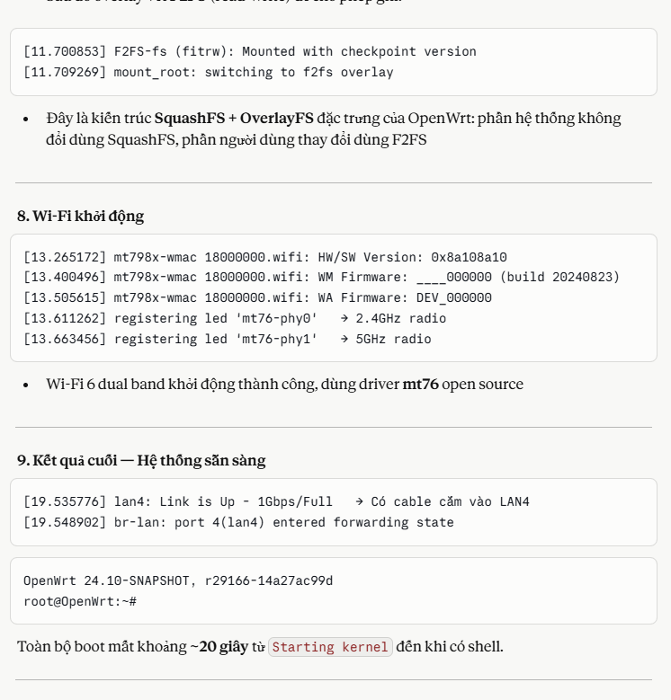
Kernel
Starting kernel ...
unable to read ssr
unable to read ssr
[ 0.000000] Booting Linux on physical CPU 0x0000000000 [0x410fd034]
[ 0.000000] Linux version 6.6.137 (quanganh@quanganh) (aarch64-openwrt-linux-musl-gcc (OpenWrt GCC 13.3.0 r29166-14a27ac99d) 13.3.0, GNU ld (GNU Binutils) 2.42) #0 SMP Sat May 2 23:38:48 20
[ 0.000000] Machine model: Bananapi BPI-R3
[ 0.000000] OF: reserved mem: 0x0000000042ff0000..0x0000000042ffffff (64 KiB) map non-reusable ramoops@42ff0000
[ 0.000000] OF: reserved mem: 0x0000000043000000..0x000000004302ffff (192 KiB) nomap non-reusable secmon@43000000
[ 0.000000] OF: reserved mem: 0x000000004fc00000..0x000000004fcfffff (1024 KiB) nomap non-reusable wmcpu-reserved@4fc00000
[ 0.000000] OF: reserved mem: 0x000000004fd00000..0x000000004fd3ffff (256 KiB) nomap non-reusable wo-emi@4fd00000
[ 0.000000] OF: reserved mem: 0x000000004fd40000..0x000000004fd7ffff (256 KiB) nomap non-reusable wo-emi@4fd40000
[ 0.000000] OF: reserved mem: 0x000000004fd80000..0x000000004ffbffff (2304 KiB) nomap non-reusable wo-data@4fd80000
[ 0.000000] Zone ranges:
[ 0.000000] DMA [mem 0x0000000040000000-0x00000000bfffffff]
[ 0.000000] DMA32 empty
[ 0.000000] Normal empty
[ 0.000000] Movable zone start for each node
[ 0.000000] Early memory node ranges
[ 0.000000] node 0: [mem 0x0000000040000000-0x0000000042ffffff]
[ 0.000000] node 0: [mem 0x0000000043000000-0x000000004302ffff]
[ 0.000000] node 0: [mem 0x0000000043030000-0x000000004fbfffff]
[ 0.000000] node 0: [mem 0x000000004fc00000-0x000000004ffbffff]
[ 0.000000] node 0: [mem 0x000000004ffc0000-0x00000000bfffffff]
[ 0.000000] Initmem setup node 0 [mem 0x0000000040000000-0x00000000bfffffff]
[ 0.000000] psci: probing for conduit method from DT.
[ 0.000000] psci: PSCIv1.1 detected in firmware.
[ 0.000000] psci: Using standard PSCI v0.2 function IDs
[ 0.000000] psci: MIGRATE_INFO_TYPE not supported.
[ 0.000000] psci: SMC Calling Convention v1.4
[ 0.000000] percpu: Embedded 18 pages/cpu s35048 r8192 d30488 u73728
[ 0.000000] pcpu-alloc: s35048 r8192 d30488 u73728 alloc=18*4096
[ 0.000000] pcpu-alloc: [0] 0 [0] 1 [0] 2 [0] 3
[ 0.000000] Detected VIPT I-cache on CPU0
[ 0.000000] CPU features: detected: GIC system register CPU interface
[ 0.000000] CPU features: kernel page table isolation disabled by kernel configuration
[ 0.000000] alternatives: applying boot alternatives
[ 0.000000] Kernel command line: root=/dev/fit0 rootwait
[ 0.000000] Dentry cache hash table entries: 262144 (order: 9, 2097152 bytes, linear)
[ 0.000000] Inode-cache hash table entries: 131072 (order: 8, 1048576 bytes, linear)
[ 0.000000] Built 1 zonelists, mobility grouping on. Total pages: 516096
[ 0.000000] mem auto-init: stack:off, heap alloc:off, heap free:off
[ 0.000000] software IO TLB: SWIOTLB bounce buffer size adjusted to 2MB
[ 0.000000] software IO TLB: area num 4.
[ 0.000000] software IO TLB: mapped [mem 0x00000000bf67f000-0x00000000bf87f000] (2MB)
[ 0.000000] Memory: 2037268K/2097152K available (8832K kernel code, 996K rwdata, 2576K rodata, 448K init, 292K bss, 59884K reserved, 0K cma-reserved)
[ 0.000000] SLUB: HWalign=64, Order=0-3, MinObjects=0, CPUs=4, Nodes=1
[ 0.000000] rcu: Hierarchical RCU implementation.
[ 0.000000] Tracing variant of Tasks RCU enabled.
[ 0.000000] rcu: RCU calculated value of scheduler-enlistment delay is 10 jiffies.
[ 0.000000] NR_IRQS: 64, nr_irqs: 64, preallocated irqs: 0
[ 0.000000] GICv3: GIC: Using split EOI/Deactivate mode
[ 0.000000] GICv3: 640 SPIs implemented
[ 0.000000] GICv3: 0 Extended SPIs implemented
[ 0.000000] Root IRQ handler: gic_handle_irq
[ 0.000000] GICv3: GICv3 features: 16 PPIs
[ 0.000000] GICv3: CPU0: found redistributor 0 region 0:0x000000000c080000
[ 0.000000] rcu: srcu_init: Setting srcu_struct sizes based on contention.
[ 0.000000] arch_timer: cp15 timer(s) running at 13.00MHz (phys).
[ 0.000000] clocksource: arch_sys_counter: mask: 0xffffffffffffff max_cycles: 0x2ff89eacb, max_idle_ns: 440795202429 ns
[ 0.000000] sched_clock: 56 bits at 13MHz, resolution 76ns, wraps every 4398046511101ns
[ 0.000064] Calibrating delay loop (skipped), value calculated using timer frequency.. 26.00 BogoMIPS (lpj=130000)
[ 0.000070] pid_max: default: 32768 minimum: 301
[ 0.002055] Mount-cache hash table entries: 4096 (order: 3, 32768 bytes, linear)
[ 0.002067] Mountpoint-cache hash table entries: 4096 (order: 3, 32768 bytes, linear)
[ 0.003631] cacheinfo: Unable to detect cache hierarchy for CPU 0
[ 0.004016] RCU Tasks Trace: Setting shift to 2 and lim to 1 rcu_task_cb_adjust=1 rcu_task_cpu_ids=4.
[ 0.004121] rcu: Hierarchical SRCU implementation.
[ 0.004123] rcu: Max phase no-delay instances is 1000.
[ 0.004442] smp: Bringing up secondary CPUs ...
[ 0.004702] Detected VIPT I-cache on CPU1
[ 0.004739] GICv3: CPU1: found redistributor 1 region 0:0x000000000c0a0000
[ 0.004767] CPU1: Booted secondary processor 0x0000000001 [0x410fd034]
[ 0.005063] Detected VIPT I-cache on CPU2
[ 0.005086] GICv3: CPU2: found redistributor 2 region 0:0x000000000c0c0000
[ 0.005096] CPU2: Booted secondary processor 0x0000000002 [0x410fd034]
[ 0.005357] Detected VIPT I-cache on CPU3
[ 0.005376] GICv3: CPU3: found redistributor 3 region 0:0x000000000c0e0000
[ 0.005386] CPU3: Booted secondary processor 0x0000000003 [0x410fd034]
[ 0.005414] smp: Brought up 1 node, 4 CPUs
[ 0.005417] SMP: Total of 4 processors activated.
[ 0.005420] CPU features: detected: 32-bit EL0 Support
[ 0.005422] CPU features: detected: CRC32 instructions
[ 0.005450] CPU features: emulated: Privileged Access Never (PAN) using TTBR0_EL1 switching
[ 0.005452] CPU: All CPU(s) started at EL2
[ 0.005454] alternatives: applying system-wide alternatives
[ 0.008551] clocksource: jiffies: mask: 0xffffffff max_cycles: 0xffffffff, max_idle_ns: 19112604462750000 ns
[ 0.008567] futex hash table entries: 1024 (order: 4, 65536 bytes, linear)
[ 0.009473] pinctrl core: initialized pinctrl subsystem
[ 0.010407] NET: Registered PF_NETLINK/PF_ROUTE protocol family
[ 0.010669] DMA: preallocated 256 KiB GFP_KERNEL pool for atomic allocations
[ 0.010697] DMA: preallocated 256 KiB GFP_KERNEL|GFP_DMA pool for atomic allocations
[ 0.010720] DMA: preallocated 256 KiB GFP_KERNEL|GFP_DMA32 pool for atomic allocations
[ 0.011024] thermal_sys: Registered thermal governor 'fair_share'
[ 0.011027] thermal_sys: Registered thermal governor 'bang_bang'
[ 0.011029] thermal_sys: Registered thermal governor 'step_wise'
[ 0.011031] thermal_sys: Registered thermal governor 'user_space'
[ 0.011070] ASID allocator initialised with 65536 entries
[ 0.011629] pstore: Using crash dump compression: deflate
[ 0.011633] pstore: Registered ramoops as persistent store backend
[ 0.011634] ramoops: using 0x10000@0x42ff0000, ecc: 0
[ 0.012778] /soc/interrupt-controller@c000000: Fixed dependency cycle(s) with /soc/interrupt-controller@c000000
[ 0.018623] Modules: 29440 pages in range for non-PLT usage
[ 0.018632] Modules: 520960 pages in range for PLT usage
[ 0.019502] cryptd: max_cpu_qlen set to 1000
[ 0.020976] SCSI subsystem initialized
[ 0.021118] libata version 3.00 loaded.
[ 0.022191] clocksource: Switched to clocksource arch_sys_counter
[ 0.023876] NET: Registered PF_INET protocol family
[ 0.023997] IP idents hash table entries: 32768 (order: 6, 262144 bytes, linear)
[ 0.025394] tcp_listen_portaddr_hash hash table entries: 1024 (order: 2, 16384 bytes, linear)
[ 0.025414] Table-perturb hash table entries: 65536 (order: 6, 262144 bytes, linear)
[ 0.025421] TCP established hash table entries: 16384 (order: 5, 131072 bytes, linear)
[ 0.025488] TCP bind hash table entries: 16384 (order: 7, 524288 bytes, linear)
[ 0.025828] TCP: Hash tables configured (established 16384 bind 16384)
[ 0.026057] MPTCP token hash table entries: 2048 (order: 4, 49152 bytes, linear)
[ 0.026167] UDP hash table entries: 1024 (order: 3, 32768 bytes, linear)
[ 0.026199] UDP-Lite hash table entries: 1024 (order: 3, 32768 bytes, linear)
[ 0.026368] NET: Registered PF_UNIX/PF_LOCAL protocol family
[ 0.026391] PCI: CLS 0 bytes, default 64
[ 0.027333] workingset: timestamp_bits=46 max_order=19 bucket_order=0
[ 0.030545] squashfs: version 4.0 (2009/01/31) Phillip Lougher
[ 0.030550] jffs2: version 2.2 (NAND) (SUMMARY) (LZMA) (RTIME) (CMODE_PRIORITY) (c) 2001-2006 Red Hat, Inc.
[ 0.068613] mtk-pcie-gen3 11280000.pcie: host bridge /soc/pcie@11280000 ranges:
[ 0.068634] mtk-pcie-gen3 11280000.pcie: Parsing ranges property...
[ 0.068643] mtk-pcie-gen3 11280000.pcie: MEM 0x0020000000..0x002fffffff -> 0x0020000000
[ 0.068750] /soc/pcie@11280000: Failed to get clk index: 0 ret: -517
[ 0.068759] mtk-pcie-gen3 11280000.pcie: failed to get clocks
[ 0.071858] Serial: 8250/16550 driver, 3 ports, IRQ sharing disabled
[ 0.072862] printk: console [ttyS0] disabled
[ 0.093220] 11002000.serial: ttyS0 at MMIO 0x11002000 (irq = 116, base_baud = 2500000) is a ST16650V2
[ 0.093259] printk: console [ttyS0] enabled
[ 0.927664] 11003000.serial: ttyS1 at MMIO 0x11003000 (irq = 117, base_baud = 1625000) is a ST16650V2
[ 0.957686] 11004000.serial: ttyS2 at MMIO 0x11004000 (irq = 118, base_baud = 1625000) is a ST16650V2
[ 0.967607] mtk_rng 1020f000.rng: registered RNG driver
[ 0.975601] loop: module loaded
[ 0.980337] spi-nand spi0.0: Winbond SPI NAND was found.
[ 0.985673] spi-nand spi0.0: 128 MiB, block size: 128 KiB, page size: 2048, OOB size: 64
[ 0.993976] 2 fixed-partitions partitions found on MTD device spi0.0
[ 1.000325] OF: Bad cell count for /soc/spi@1100a000/spi_nand@0/partitions
[ 1.007253] OF: Bad cell count for /soc/spi@1100a000/spi_nand@0/partitions
[ 1.014334] Creating 2 MTD partitions on "spi0.0":
[ 1.019115] 0x000000200000-0x000008000000 : "ubi"
[ 1.159813] ubi0: default fastmap pool size: 50
[ 1.164355] ubi0: default fastmap WL pool size: 25
[ 1.169129] ubi0: attaching mtd0
[ 4.880597] ubi0: scanning is finished
[ 4.925715] ubi0: attached mtd0 (name "ubi", size 126 MiB)
[ 4.931197] ubi0: PEB size: 131072 bytes (128 KiB), LEB size: 126976 bytes
[ 4.938059] ubi0: min./max. I/O unit sizes: 2048/2048, sub-page size 2048
[ 4.944829] ubi0: VID header offset: 2048 (aligned 2048), data offset: 4096
[ 4.951768] ubi0: good PEBs: 1008, bad PEBs: 0, corrupted PEBs: 0
[ 4.957842] ubi0: user volume: 3, internal volumes: 1, max. volumes count: 128
[ 4.965046] ubi0: max/mean erase counter: 2/0, WL threshold: 4096, image sequence number: 1642748947
[ 4.974155] ubi0: available PEBs: 493, total reserved PEBs: 515, PEBs reserved for bad PEB handling: 20
[ 4.983528] ubi0: background thread "ubi_bgt0d" started, PID 226
[ 4.985791] block ubiblock0_1: created from ubi0:1(rootfs)
[ 4.995005] ubiblock: device ubiblock0_1 (rootfs) set to be root filesystem
[ 5.002069] 0x000000000000-0x000000200000 : "bl2"
[ 5.146672] mtk_soc_eth 15100000.ethernet eth0: mediatek frame engine at 0xffffffc081700000, irq 123
[ 5.156455] mtk_soc_eth 15100000.ethernet eth1: mediatek frame engine at 0xffffffc081700000, irq 123
[ 5.166152] i2c_dev: i2c /dev entries driver
[ 5.172422] mtk-wdt 1001c000.watchdog: Watchdog enabled (timeout=31 sec, nowayout=0)
[ 5.180994] NET: Registered PF_INET6 protocol family
[ 5.186601] Segment Routing with IPv6
[ 5.190271] In-situ OAM (IOAM) with IPv6
[ 5.194236] NET: Registered PF_PACKET protocol family
[ 5.199336] 8021q: 802.1Q VLAN Support v1.8
[ 5.217012] mtk-pcie-gen3 11280000.pcie: host bridge /soc/pcie@11280000 ranges:
[ 5.224353] mtk-pcie-gen3 11280000.pcie: Parsing ranges property...
[ 5.230610] mtk-pcie-gen3 11280000.pcie: MEM 0x0020000000..0x002fffffff -> 0x0020000000
[ 5.239075] debugfs: File 'type' in directory 'phy-soc:t-phy@11c00000.0' already present!
[ 5.247237] debugfs: File 'efuse' in directory 'phy-soc:t-phy@11c00000.0' already present!
[ 5.255479] debugfs: File 'intr' in directory 'phy-soc:t-phy@11c00000.0' already present!
[ 5.263634] debugfs: File 'tx-imp' in directory 'phy-soc:t-phy@11c00000.0' already present!
[ 5.271960] debugfs: File 'rx-imp' in directory 'phy-soc:t-phy@11c00000.0' already present!
[ 5.612218] mtk-pcie-gen3 11280000.pcie: PCIe link down, current LTSSM state: detect.quiet (0x1)
[ 5.621033] mtk-pcie-gen3: probe of 11280000.pcie failed with error -110
[ 5.714515] mt7530-mdio mdio-bus:1f: configuring for fixed/2500base-x link mode
[ 5.723558] mt7530-mdio mdio-bus:1f: Link is Up - 2.5Gbps/Full - flow control rx/tx
[ 5.734040] mt7530-mdio mdio-bus:1f wan (uninitialized): PHY [mt7530-0:00] driver [MediaTek MT7531 PHY] (irq=128)
[ 5.756122] mt7530-mdio mdio-bus:1f lan1 (uninitialized): PHY [mt7530-0:01] driver [MediaTek MT7531 PHY] (irq=129)
[ 5.777988] mt7530-mdio mdio-bus:1f lan2 (uninitialized): PHY [mt7530-0:02] driver [MediaTek MT7531 PHY] (irq=130)
[ 5.799839] mt7530-mdio mdio-bus:1f lan3 (uninitialized): PHY [mt7530-0:03] driver [MediaTek MT7531 PHY] (irq=131)
[ 5.821686] mt7530-mdio mdio-bus:1f lan4 (uninitialized): PHY [mt7530-0:04] driver [MediaTek MT7531 PHY] (irq=132)
[ 5.832984] mtk_soc_eth 15100000.ethernet eth0: entered promiscuous mode
[ 5.839701] DSA: tree 0 setup
[ 5.843201] clk: Disabling unused clocks
[ 5.869924] Waiting for root device /dev/fit0...
[ 5.910094] mmc0: host does not support reading read-only switch, assuming write-enable
[ 5.924022] mmc0: new high speed SDHC card at address e624
[ 5.930302] mmcblk0: mmc0:e624 SC32G 29.7 GiB
[ 5.940697] Alternate GPT is invalid, using primary GPT.
[ 5.946019] mmcblk0: p1 p2 p3 p4 p5 p6 p7
[ 5.953214] FIT: Detected U-Boot 2024.10-OpenWrt-r29166-14a27ac99d
[ 5.959391] FIT: Selected configuration: "config-mt7986a-bananapi-bpi-r3" (OpenWrt bananapi_bpi-r3)
[ 5.968428] FIT: kernel sub-image 0x00001000..0x0059fc46 "kernel-1" (ARM64 OpenWrt Linux-6.6.137)
[ 5.978241] FIT: flat_dt sub-image 0x005a0000..0x005a7cbe "fdt-1" (ARM64 OpenWrt bananapi_bpi-r3 device tree blob)
[ 5.989443] FIT: flat_dt sub-image 0x005a8000..0x005a83dd "fdt-mt7986a-bananapi-bpi-r3-emmc" (ARM64 OpenWrt bananapi_bpi-r3 device tree overlay mt7986a-bananapi-bpi-r3-emmc)
[ 6.005762] FIT: flat_dt sub-image 0x005a9000..0x005a948d "fdt-mt7986a-bananapi-bpi-r3-nand" (ARM64 OpenWrt bananapi_bpi-r3 device tree overlay mt7986a-bananapi-bpi-r3-nand)
[ 6.022077] FIT: flat_dt sub-image 0x005aa000..0x005aa4bd "fdt-mt7986a-bananapi-bpi-r3-nor" (ARM64 OpenWrt bananapi_bpi-r3 device tree overlay mt7986a-bananapi-bpi-r3-nor)
[ 6.038218] FIT: flat_dt sub-image 0x005ab000..0x005ab343 "fdt-mt7986a-bananapi-bpi-r3-sd" (ARM64 OpenWrt bananapi_bpi-r3 device tree overlay mt7986a-bananapi-bpi-r3-sd)
[ 6.054186] FIT: flat_dt sub-image 0x005ac000..0x005ac555 "fdt-mt7986a-bananapi-bpi-r3-respeaker-2mics" (ARM64 OpenWrt bananapi_bpi-r3 device tree overlay mt7986a-bananapi-bpi-r3-reer-2mics)
[ 6.072406] FIT: filesystem sub-image 0x005ad000..0x00af2fff "rootfs-1" (ARM64 OpenWrt bananapi_bpi-r3 rootfs)
[ 6.083338] block mmcblk0p7: mapped 1 uImage.FIT filesystem sub-image as /dev/fit0
[ 6.091146] block mmcblk0p7: mapped remaining space as /dev/fitrw
[ 6.131543] VFS: Mounted root (squashfs filesystem) readonly on device 259:0.
[ 6.138836] Freeing unused kernel memory: 448K
[ 6.143293] Run /sbin/init as init process
[ 6.147372] with arguments:
[ 6.150323] /sbin/init
[ 6.153018] with environment:
[ 6.156142] HOME=/
[ 6.158487] TERM=linux
[ 6.303599] init: Console is alive
[ 6.307081] init: - watchdog -
[ 6.620641] kmodloader: loading kernel modules from /etc/modules-boot.d/*
[ 6.649458] usbcore: registered new interface driver usbfs
[ 6.655003] usbcore: registered new interface driver hub
[ 6.660331] usbcore: registered new device driver usb
[ 6.665969] gpio_button_hotplug: loading out-of-tree module taints kernel.
[ 6.676815] xhci-mtk 11200000.usb: supply vbus not found, using dummy regulator
[ 6.684234] xhci-mtk 11200000.usb: supply vusb33 not found, using dummy regulator
[ 6.692568] xhci-mtk 11200000.usb: xHCI Host Controller
[ 6.697794] xhci-mtk 11200000.usb: new USB bus registered, assigned bus number 1
[ 6.708311] xhci-mtk 11200000.usb: hcc params 0x01403f99 hci version 0x110 quirks 0x0000000000200010
[ 6.717466] xhci-mtk 11200000.usb: irq 134, io mem 0x11200000
[ 6.723318] xhci-mtk 11200000.usb: xHCI Host Controller
[ 6.728529] xhci-mtk 11200000.usb: new USB bus registered, assigned bus number 2
[ 6.735909] xhci-mtk 11200000.usb: Host supports USB 3.2 Enhanced SuperSpeed
[ 6.743316] hub 1-0:1.0: USB hub found
[ 6.747076] hub 1-0:1.0: 2 ports detected
[ 6.751335] usb usb2: We don't know the algorithms for LPM for this host, disabling LPM.
[ 6.759696] hub 2-0:1.0: USB hub found
[ 6.763464] hub 2-0:1.0: 1 port detected
[ 6.770670] kmodloader: done loading kernel modules from /etc/modules-boot.d/*
[ 6.779756] init: - preinit -
[ 7.011338] mtk_soc_eth 15100000.ethernet eth0: configuring for fixed/2500base-x link mode
[ 7.019908] mtk_soc_eth 15100000.ethernet eth0: Link is Up - 2.5Gbps/Full - flow control rx/tx
[ 7.038200] mt7530-mdio mdio-bus:1f lan1: configuring for phy/gmii link mode
Press the [f] key and hit [enter] to enter failsafe mode
Press the [1], [2], [3] or [4] key and hit [enter] to select the debug level
[ 7.202210] usb 1-1: new high-speed USB device number 2 using xhci-mtk
[ 7.394363] hub 1-1:1.0: USB hub found
[ 7.402007] hub 1-1:1.0: 4 ports detected
[ 9.572197] random: crng init done
[ 11.700853] F2FS-fs (fitrw): Mounted with checkpoint version = 3999c4ea
[ 11.709269] mount_root: switching to f2fs overlay
[ 11.715886] overlayfs: null uuid detected in lower fs '/', falling back to xino=off,index=off,nfs_export=off.
[ 11.729808] urandom-seed: Seeding with /etc/urandom.seed
[ 11.773752] procd: - early -
[ 11.776680] procd: - watchdog -
[ 12.307388] procd: - watchdog -
[ 12.310879] procd: - ubus -
[ 12.464034] procd: - init -
Please press Enter to activate this console.
[ 12.718883] kmodloader: loading kernel modules from /etc/modules.d/*
[ 12.746947] i2c-gpio i2c-gpio-0: using lines 528 (SDA) and 529 (SCL)
[ 12.753663] i2c-gpio i2c-gpio-1: using lines 530 (SDA) and 531 (SCL)
[ 12.763453] crypto-safexcel 10320000.crypto: EIP97:230(0,1,4,4)-HIA:270(0,5,5),PE:150/433(alg:7fcdfc00)/0/0/0
[ 12.777878] Loading modules backported from Linux version v6.12.61-0-gdcbeffaf66d0
[ 12.785464] Backport generated by backports.git v6.1.110-1-35-g410656ef
[ 12.796904] sfp sfp-1: Host maximum power 3.0W
[ 12.801957] sfp sfp-2: Host maximum power 3.0W
[ 12.859788] urngd: v1.0.2 started.
[ 13.265172] mt798x-wmac 18000000.wifi: HW/SW Version: 0x8a108a10, Build Time: 20240823160739a
[ 13.265172]
[ 13.400496] mt798x-wmac 18000000.wifi: WM Firmware Version: ____000000, Build Time: 20240823160804
[ 13.505615] mt798x-wmac 18000000.wifi: WA Firmware Version: DEV_000000, Build Time: 20240823160840
[ 13.611262] mt798x-wmac 18000000.wifi: registering led 'mt76-phy0'
[ 13.663456] mt798x-wmac 18000000.wifi: registering led 'mt76-phy1'
[ 13.762416] PPP generic driver version 2.4.2
[ 13.767502] NET: Registered PF_PPPOX protocol family
[ 13.774884] kmodloader: done loading kernel modules from /etc/modules.d/*
[ 15.708564] mtk_soc_eth 15100000.ethernet eth0: Link is Down
[ 15.723997] mtk_soc_eth 15100000.ethernet eth0: configuring for fixed/2500base-x link mode
[ 15.732456] mtk_soc_eth 15100000.ethernet eth0: Link is Up - 2.5Gbps/Full - flow control rx/tx
[ 15.738862] mt7530-mdio mdio-bus:1f lan1: configuring for phy/gmii link mode
[ 15.751964] br-lan: port 1(lan1) entered blocking state
[ 15.757206] br-lan: port 1(lan1) entered disabled state
[ 15.762447] mt7530-mdio mdio-bus:1f lan1: entered allmulticast mode
[ 15.768697] mtk_soc_eth 15100000.ethernet eth0: entered allmulticast mode
[ 15.778455] mt7530-mdio mdio-bus:1f lan1: entered promiscuous mode
[ 15.796712] mt7530-mdio mdio-bus:1f lan2: configuring for phy/gmii link mode
[ 15.807581] br-lan: port 2(lan2) entered blocking state
[ 15.812861] br-lan: port 2(lan2) entered disabled state
[ 15.818114] mt7530-mdio mdio-bus:1f lan2: entered allmulticast mode
[ 15.826175] mt7530-mdio mdio-bus:1f lan2: entered promiscuous mode
[ 15.840993] mt7530-mdio mdio-bus:1f lan3: configuring for phy/gmii link mode
[ 15.851796] br-lan: port 3(lan3) entered blocking state
[ 15.857057] br-lan: port 3(lan3) entered disabled state
[ 15.862327] mt7530-mdio mdio-bus:1f lan3: entered allmulticast mode
[ 15.870439] mt7530-mdio mdio-bus:1f lan3: entered promiscuous mode
[ 15.885501] mt7530-mdio mdio-bus:1f lan4: configuring for phy/gmii link mode
[ 15.896191] br-lan: port 4(lan4) entered blocking state
[ 15.901416] br-lan: port 4(lan4) entered disabled state
[ 15.906732] mt7530-mdio mdio-bus:1f lan4: entered allmulticast mode
[ 15.915009] mt7530-mdio mdio-bus:1f lan4: entered promiscuous mode
[ 15.924265] mt7530-mdio mdio-bus:1f sfp2: configuring for inband/2500base-x link mode
[ 15.933691] br-lan: port 5(sfp2) entered blocking state
[ 15.938906] br-lan: port 5(sfp2) entered disabled state
[ 15.944168] mt7530-mdio mdio-bus:1f sfp2: entered allmulticast mode
[ 15.952587] mt7530-mdio mdio-bus:1f sfp2: entered promiscuous mode
[ 15.962063] mtk_soc_eth 15100000.ethernet eth1: configuring for inband/2500base-x link mode
[ 15.972276] br-wan: port 1(eth1) entered blocking state
[ 15.977508] br-wan: port 1(eth1) entered disabled state
[ 15.982788] mtk_soc_eth 15100000.ethernet eth1: entered allmulticast mode
[ 15.989757] mtk_soc_eth 15100000.ethernet eth1: entered promiscuous mode
[ 16.004994] mt7530-mdio mdio-bus:1f wan: configuring for phy/gmii link mode
[ 16.015717] br-wan: port 2(wan) entered blocking state
[ 16.020855] br-wan: port 2(wan) entered disabled state
[ 16.026034] mt7530-mdio mdio-bus:1f wan: entered allmulticast mode
[ 16.034107] mt7530-mdio mdio-bus:1f wan: entered promiscuous mode
[ 19.535776] mt7530-mdio mdio-bus:1f lan4: Link is Up - 1Gbps/Full - flow control rx/tx
[ 19.535800] br-lan: port 4(lan4) entered blocking state
[ 19.548902] br-lan: port 4(lan4) entered forwarding state
BusyBox v1.36.1 (2026-05-02 23:38:48 UTC) built-in shell (ash)

